Slide 2
Chapter 18
Footings, Foundations, and Concrete

Slide 3
Objectives
Describe the procedure for staking out a house location.
List the major considerations when designing a footing for a residential foundation.
Analyze a residential building project to determine the appropriate type of foundation wall.

Slide 4
Objectives
Discuss the design considerations for wood, concrete, and masonry foundation walls.
Calculate the load to be supported by a beam.
Describe the characteristics of concrete, concrete blocks, masonry, and pavers used in residential construction.

Slide 5
Staking Out House Location
Site plan provides necessary dimensions
Measuring tape, contractor’s level, and possibly a transit are required
Locate each corner of house
Use 9-12-15 unit method for square corners
Check accuracy by diagonal measurement

Slide 6
9-12-15 Unit Method
Goodheart-Willcox Publisher

Slide 7
Batter Boards in Place
Goodheart-Willcox Publisher

Slide 8
Excavation
Top soil should be removed and saved
Backhoe is generally used to excavate
Excavation for footings should extend at least 6" into undisturbed earth and at least 6" below frost penetration
No backfilling under footings

Slide 9
Excavation
Must be large enough to allow space to work on the foundation
Excavation wall should slope away from bottom of the excavation
Gentle slope in sandy soil
Nearly vertical in clay

Slide 10
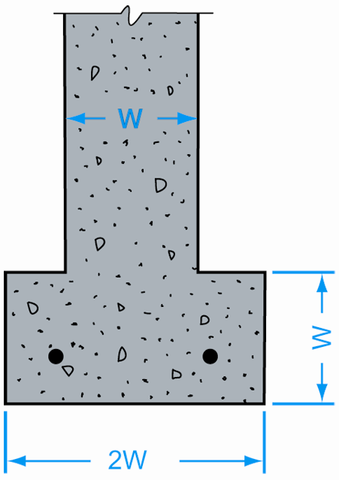
Footings
Increase supporting capacity of foundation wall
Size is typically based on foundation wall thickness
Footings are generally poured concrete
Goodheart-Willcox Publisher

Slide 11
Footing Specifications
Thickness generally equals foundation wall thickness; width is twice the wall thickness
Poor soil may require wider footings
Footings should be large enough to minimize differences in settlement
Check code recommendations
Use steel reinforcement bars (rebar)

Slide 12
Fireplace and Chimney Footings
More massive than regular house footings
Should be reinforced with steel
12 inches thick
Extend 6 inches beyond perimeter of chimney
Cast integrally with house footing

Slide 13
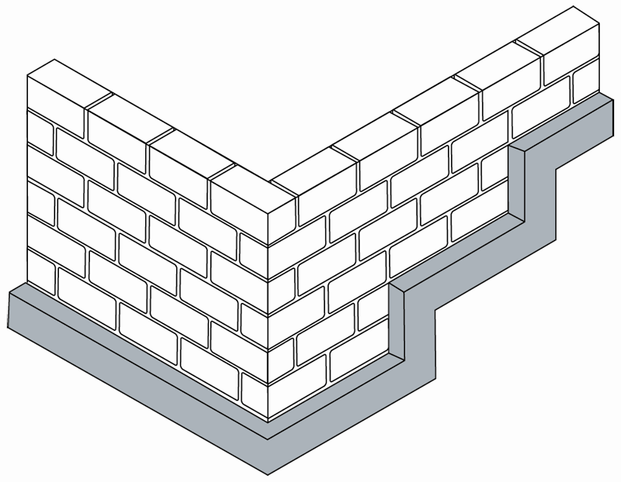
Stepped Footing
Steps should be multiples of 8 inches in masonry construction
Goodheart-Willcox Publisher

Slide 14
Foundation Walls
Extend from first floor to footing
May also be basement walls
Variety of materials may be used
Cast concrete, concrete block, pressure-treated wood, and stone or brick

Slide 15
Types of Foundation Walls
Goodheart-Willcox Publisher

Slide 16
T-Foundation Application
Goodheart-Willcox Publisher

Slide 17
Slab Foundations
Slab foundation
Extension of slab floor (monolithic slab foundation)
Cast when the floor is placed
Should extend below frost line
Reinforcement is recommended
Advantages: Less time, labor, and expense

Slide 18
Stem Wall
Stem wall
Typically used in crawl space foundation or slab foundation
May be part of monolithic slab foundation or may be poured separately
Often used in hurricane-prone areas

Slide 19
Slab Foundation Application
Goodheart-Willcox Publisher

Slide 20
Pier and Column Foundations
Difference between piers and columns is height
Pier foundation
Sometimes replaces T-foundation under house
Often used in long crawl space
Post (column) foundation
Used in basements where span is too long
Column has a footing and post

Slide 21
Parts of a Pier Foundation
Goodheart-Willcox Publisher

Slide 22
Post (Column) Foundation
Goodheart-Willcox Publisher

Slide 23
Wood Foundations
Wood foundations
Below-grade, pressure-treated, plywood-sheathed stud wall
Popular where winter weather stops construction
Accepted by IRC
Used in basement or crawl space construction

Slide 24
Wood Foundations
Green Architecture
Determine feasibility of using wood as opposed to concrete in areas with high water tables or high rainfall
Check local building codes
Check chemicals used to preserve wood

Slide 25
Wood Foundation Construction
Excavation should allow for 2" sand or 6" crushed stone for the footing
Base must be perfectly level
Footing plates are 2 × 8, 2 × 10, or 2 × 12 pressure-treated material
Foundation walls are 2 × 4 or 2 × 6 stud frame

Slide 26
Wood Foundation Construction
Fasteners are silicon bronze, copper, or zinc-coated steel
Sheathing is pressure-treated plywood
All framing lumber is pressure-treated
Screed board nailed inside of foundation wall
Backfill after basement floor has cured and first floor is installed

Slide 27
Concrete and Masonry Basement Walls
Factors influencing strength and stability:
Height and thickness of wall
Bond of mortar in masonry wall
Vertical loading
Support from crosswalls, pilasters, wall stiffeners
Support from first floor framing
Lateral earth pressure can vary

Slide 28
Pilasters
May be used to strengthen basement walls
Built at the same time as wall
Masonry wall pilasters are usually 8" × 16" in an 8" thick wall
Distance between pilasters should not exceed 15' in an 8" wall and 18' in a 10" wall
Also used to stiffen foundation walls

Slide 29
Pilasters
Goodheart-Willcox Publisher

Slide 30
Wall Stiffeners
Alternative to pilasters
#4 bar is placed in one core of block from footing to top plate
Another method is horizontal steel joint reinforcement at 16" intervals vertically

Slide 31
Basement Wall Construction
Top of wall should be at least 8" above the grade in frame construction
Anchor wood sills to basement wall
Provide at least 7' −5" headroom
Anchor load-bearing crosswalls w/ metal tie bars

Slide 32
Basement Wall Construction
Solid cap used to spread load over wall
Damp-proofing required on outside of basement wall
Parge coat and sealer
Excess groundwater removal system may be needed

Slide 33
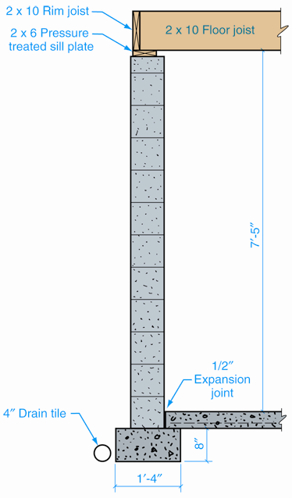
Basement Wall Section
Goodheart-Willcox Publisher

Slide 34
Beams and Girders
Support floor joists over long spans
May be wood or metal
Wood beams may be built up or solid
Steel beams may be S-beams or W-beams
Bearing wall supports part of load

Slide 35
Structure Loads
Size of beam is based on weight of structure
Live load
Fixed or moving weights (furniture, appliances, occupants, snow on roof)
Dead load
Weight of structure itself (roofing, siding, joists)

Slide 36
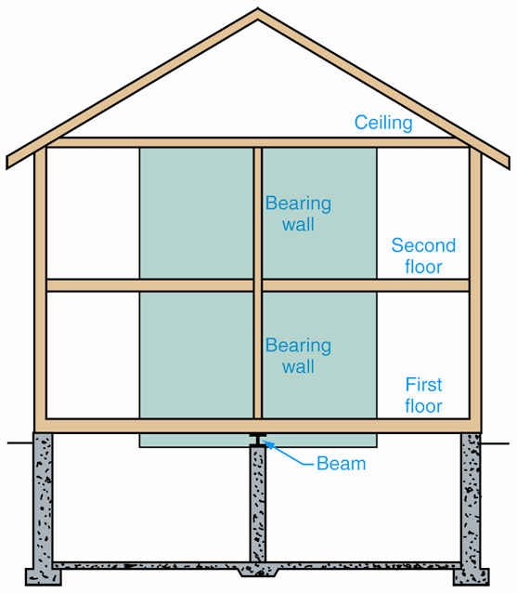
Weight Supported by Beam
Shaded area represents weight supported by W-beam
Goodheart-Willcox Publisher

Slide 37
Load Assumptions
First floor and second floor
Live load + dead load = 50 pounds per square foot
Ceiling
Live + dead load = 30 pounds per square foot
Walls
Dead load = 10 pounds per square foot
Roof
No load on beam

Slide 38
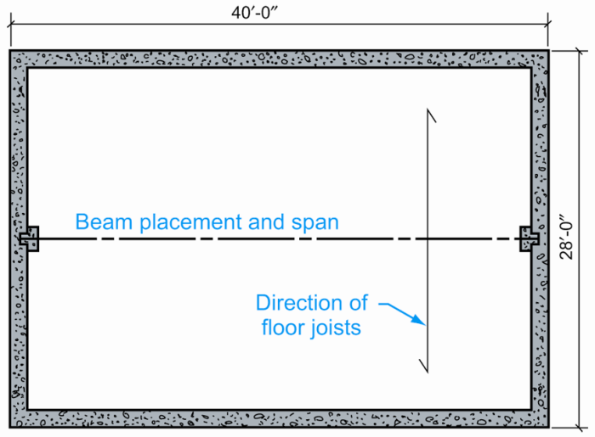
Weight Calculations: Example
Two-story frame structure
28' × 40'
Area of house
1120 sq. ft. per floor
Wall area
320 sq. ft. per wall
Assumes bearing wall on each floor
Goodheart-Willcox Publisher

Slide 39
Weight Calculations: Example
Weight of first floor = 56,000 lbs
Weight of second floor = 56,000 lbs
Weight of ceiling = 33,600 lbs
Total weight = 145,600 lbs
Half bears on the beam = 72,800 lbs
First + second floor wall weight = 6,400 lbs
Weight bearing on the beam = 79,200 lbs

Slide 40
Beam Calculations: Example
Length of beam = 40 feet
Three columns reduce span to 10'-0" and 19.8 kips
1 kip = 1000 lbs
8" × 6 1/2" WF beam will support 23 kips

Slide 41
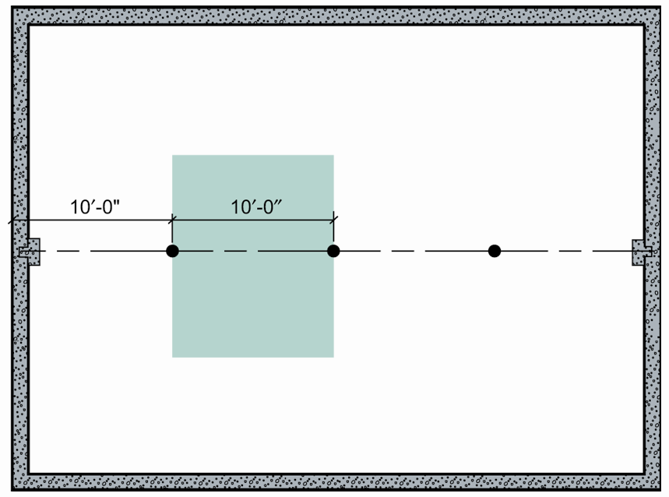
Beam Calculations: Example
Three supporting posts are added
Goodheart-Willcox Publisher

Slide 42
Post Calculations: Example
Post selection
Size is determined by weight to be supported and length of post
Post must support 26 kips
Post length is 8 feet
3" post will support 34 kips

Slide 43
Lintels
Lintel
Horizontal structural member that supports load over opening
Made of precast concrete, cast-in-place concrete, lintel blocks, or steel angles
Bearing surface of steel angle lintel extends into the masonry at least 4"

Slide 44
Types of Lintels
Goodheart-Willcox Publisher

Slide 45
Concrete
Ordered by cubic yard
“Six-bag mix” recommended
Composed of cement, sand, large aggregate, and water
Work air pockets out by vibrating or tamping

Slide 46
Concrete Finishing
Screed is used to smooth the surface
Float is used to embed large aggregate, remove imperfections, and consolidate mortar
Trowel is used to develop a hard, smooth surface

Slide 47
Contraction Joints
Contraction joints are used to minimize and control cracking
Place in line with interior columns
Place at changes in width of slab
Maximum spacing of joints is 20 feet

Slide 48
Floor Slabs
Concrete floor slab should be placed on 4" to 6" of compacted sand
Slab thickness is 4" minimum
Slabs should not be bonded to footings or columns
1" thick sand cushion may be used to separate slab from footing

Slide 49
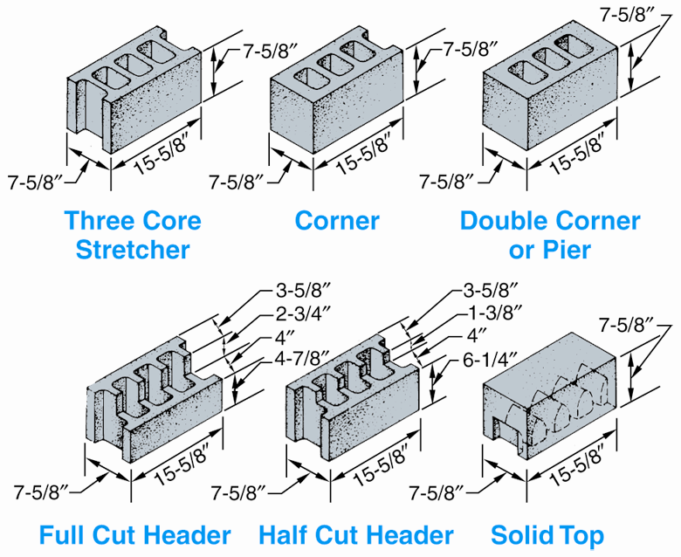
Concrete Blocks
Hollow concrete masonry units form exterior and interior walls
Nominal size: 8 × 8 × 16
Actual size:
7-5/8" × 7-5/8" × 15-5/8" allows for 3/8" mortar joint
Goodheart-Willcox Publisher

Slide 50
Paving
Rigid paving system
Compacted subgrade, base, reinforced concrete slab, mortar setting bed, pavers w/ mortars joints
Flexible paving system
Installed on compacted sand, crushed stone
Rigid edge restraint prevents creep

Slide 51
Aptitudes and Abilities
Employability
Aptitude
Natural talent
Ability to learn something quickly and easily
Ability
Skill developed with practice

