Slide 2
Chapter 19
Sill and Floor Construction

Slide 3
Objectives
Describe the components of a floor system.
Explain the difference between platform and balloon framing.
Determine proper joist sizes using a typical span data chart.
Plan the appropriate floor support using joists or trusses for a structure.

Slide 4
Objectives
Select the appropriate engineered wood products for specific applications in residential construction.
Explain the principles of post and beam construction.

Slide 5
Introduction
Framing methods vary from one section of the country to another
Two basic types of floor framing are platform framing and balloon framing
Use plates, joists, and studs
Post and beam construction is used for walls and floors

Slide 6
Platform Framing
Floor joists form platform on which walls rest
Another platform rests on top of walls when there is a second story
Advantages include:
Easy and fast to construct
Shrinkage is uniform
Platform provides a firestop between floors

Slide 7
Platform Framing
The sill is starting point in constructing a floor
Lowest member of structure’s frame
Rests on foundation
Supports floor joists or studs
Generally 2 x 6 lumber
Box sill construction generally used in platform framing

Slide 8
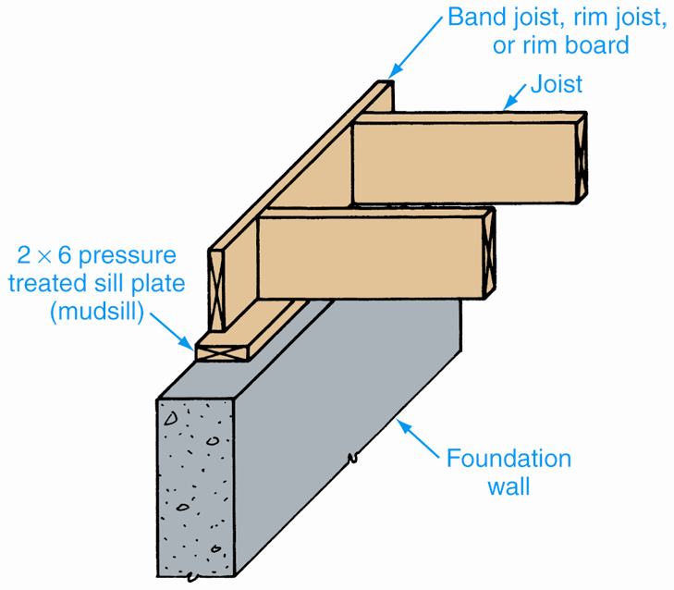
Platform Framing
Box sill construction
Goodheart-Willcox Publisher

Slide 9
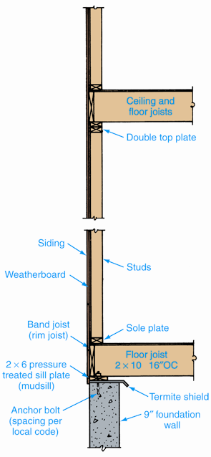
Platform Framing
Box sill construction
Detail of first and second floor
Goodheart-Willcox Publisher

Slide 10
Balloon Framing
Wall studs rest directly on the sill plate
Each floor “hangs” from the studs
Advantages: Small potential shrinkage, good vertical stability
Disadvantages: Less safe work surface, need to add firestops
Two types of sill construction: Solid (standard) or T-sill

Slide 11
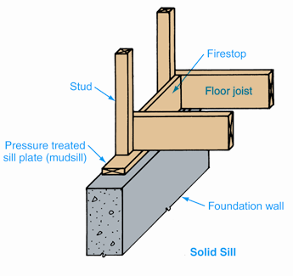
Solid (Standard) Sill Construction
Studs nailed directly to sill and joists
No header used
Goodheart-Willcox Publisher

Slide 12
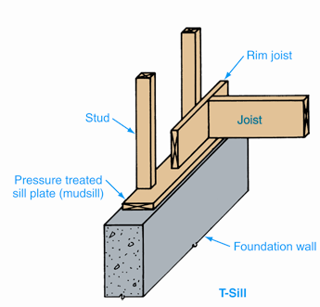
T-sill Construction
Header rests on sill
Serves as firestop
Studs rest on sill
Nailed to header and to sill plate
Goodheart-Willcox Publisher

Slide 13
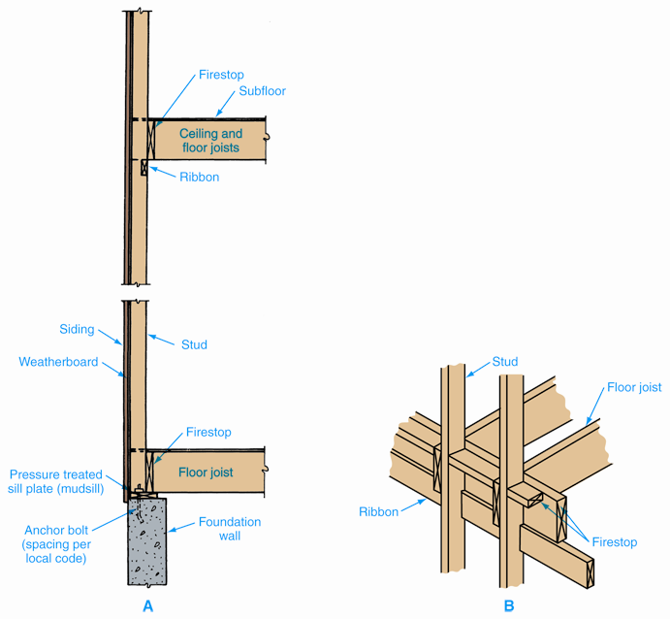
Balloon Framing
First and second floor construction
Joists supported by a ribbon and nailed to studs on second floor level
Goodheart-Willcox Publisher

Slide 14
Joists and Beams
Joists provide support for floor
Usually made from southern yellow pine, fir, larch, hemlock, or spruce
Engineered wood and metal joists also available
Floor joists range in size from 2 x 6 to 2 x 12

Slide 15
Using a Span Data Table
Select species of wood to be used
Select appropriate live load
Determine lumber grade to be used
Scan the lumber grade row and note maximum spans
Select joist size and spacing that will support desired live load and dead load

Slide 16
Span Data: Example
Span is 14'-0; Number 1 dense southern pine
Live load is 30 pounds per square foot
Chart shows following choices:
2 x 8 joists 12"OC or 16"OC
2 x 10 joists 12"OC, 16"OC, or 24"OC
2 x 12 joists 12"OC, 16"OC, or 24"OC
Best selection: 2 x 8 joists, 16"OC, will span up to 14'-5"

Slide 17
Steel Floor Joists
Depths typically 6" to 12"
Thicknesses from 0.033" to 0.097"
Common spacing 24"OC, but other spacing also used

Slide 18
Engineered Floor Joists
Green Architecture
Sustainable alternative to solid wood joists
Can be made from wood chips and other wood products formerly considered waste
Stronger, and can span longer distances than solid wood joists
Fewer joists needed to meet building codes

Slide 19
Joists
Size based on span, load, species and grade of wood, and joist spacing
When using metal joists, consider gauge of metal instead of species and grade of lumber
Spaced 12", 16", or 24"OC

Slide 20
Beams
When span too great for unsupported joists, beam or load-bearing wall reduces span
Beam can be solid timber, built-up, or metal S- or W-beam
Load-bearing walls may be concrete block, cast concrete, or frame construction

Slide 21
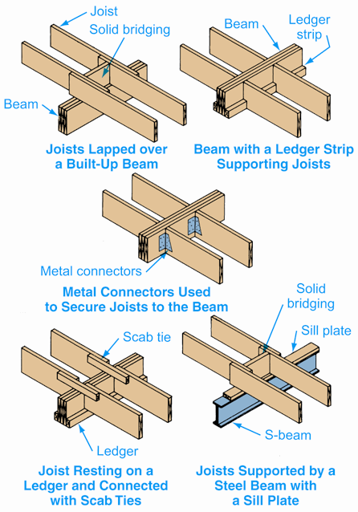
Supporting Floor Joists with Beams
Goodheart-Willcox Publisher

Slide 22
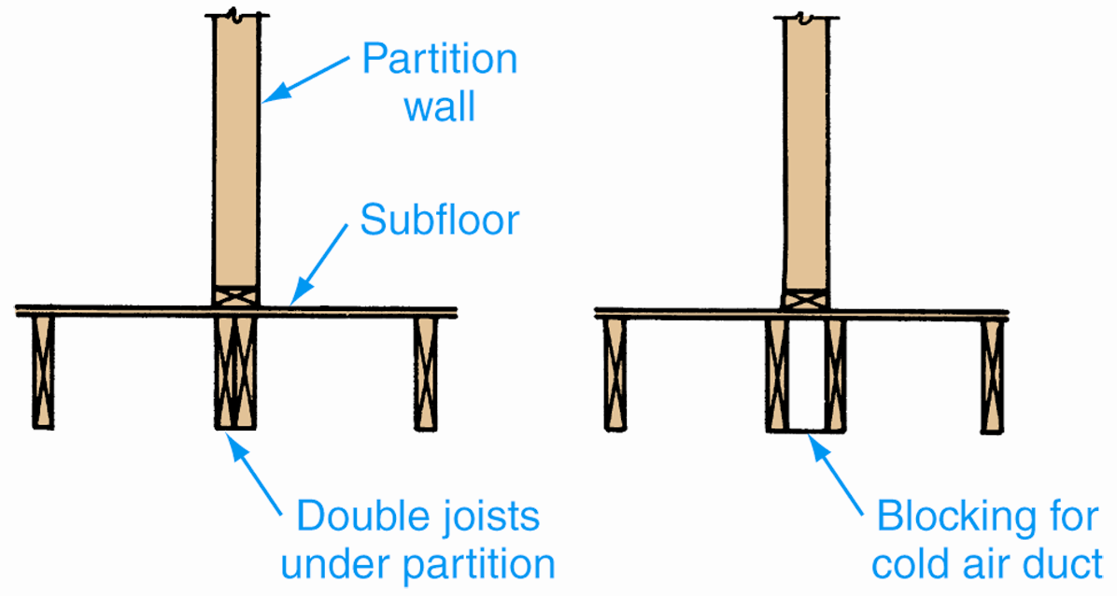
Supporting Partition Walls
Partition walls that run parallel to floor joists require added support
Goodheart-Willcox Publisher

Slide 23
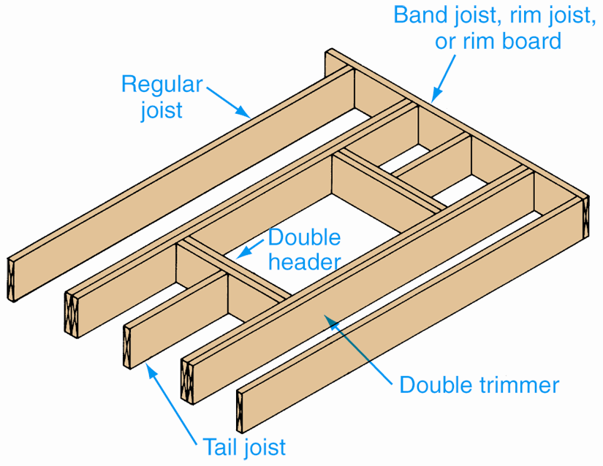
Openings in Floor
Openings in the floor for stairs and chimneys required double joist framing
Goodheart-Willcox Publisher

Slide 24
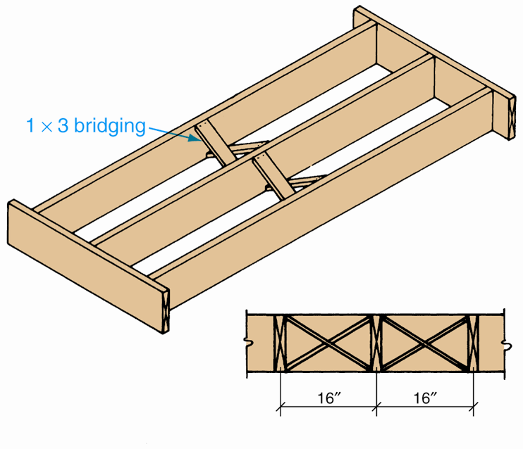
Cross Bridging
Stiffens floor, spreads load over broader area
Bridging boards or metal bridging are used
Goodheart-Willcox Publisher

Slide 25
Floor Trusses
Rigid frameworks support loads over spans
Used in place of floor joists in residential construction
Consist of top chord, bottom chord, and web
Chords are horizontal flanges on top and bottom of truss
Web is truss framework between the chords

Slide 26
Engineered Floor Trusses
Designed using computers
Usually fabricated from 2 x 4 or 2 x 6 lumber and spaced 24"OC
Have built-in cambers
Stress-graded lumber reduces material used
Webs may be metal or wood

Slide 27
Subfloor
Affixed to top of floor joists
Provides surface for underlayment
Made from plywood, tongue-and-groove boards, common boards, and other panel products

Slide 28
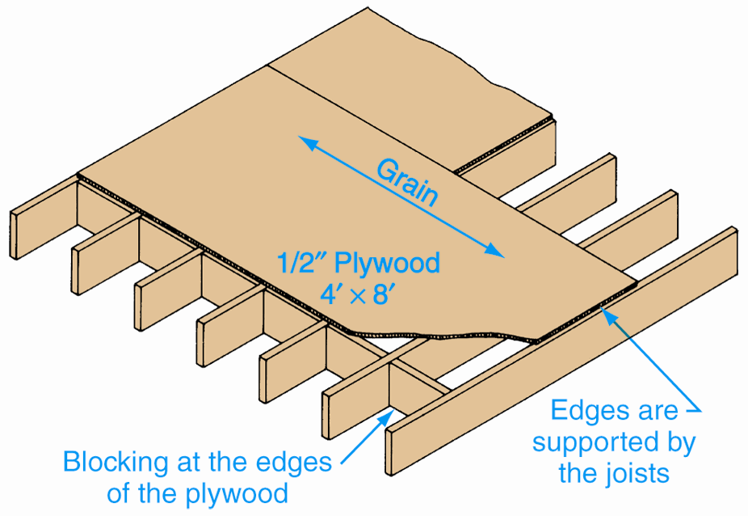
Installing Subfloor Panels
Joist spacing must be accurate
All panel edges must be supported
Goodheart-Willcox Publisher

Slide 29
Cantilevered (Overhanging) Joists
Section of floor projects beyond a lower level
When floor joists run perpendicular to cantilevered section, longer joists form cantilever
When joists are parallel to overhanging area, cantilevered joists are required

Slide 30
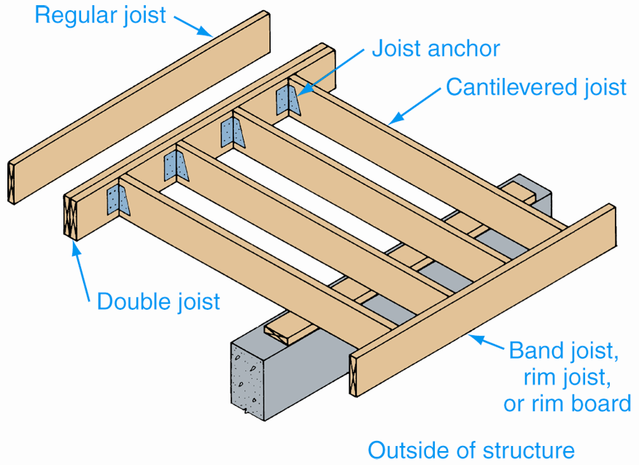
Cantilevered Joists
Joists should extend inside the structure twice the distance they overhang
Goodheart-Willcox Publisher

Slide 31
Framing Under Slate or Tile
Requires substantial base
Concrete base needs lowered floor framing
Smaller size joists reduce space between joists
Beams under section used to support added weight
Cement mortar mix used

Slide 32
Engineered Wood Products (EWPs)
Combine wood veneers, fibers with adhesives to form beams, headers, joists, and panels
Advantages: High quality and consistency; no knots, checks, warps; 8% to 12% moisture content; design flexibility
Disadvantage: Lack of industry standards

Slide 33
Oriented Strand Board (OSB)
Made from long strands of wood and resin
Aspen is preferred wood
Advantages:
Less expensive than plywood
Unique appearance
Disadvantages:
Subject to swelling
Not designed for exposure to elements

Slide 34
Oriented Strand Board (OSB)
Made in panel sizes, typically 4' x 8'
Available in sizes up to 8' x 24'
1/8" space along edges prevents buckling
Use same nailing schedules used on plywood

Slide 35
Parallel Strand Lumber (PSL)
Made from thin strands of wood
Used for beams, columns, headers
High strength and span capacity
Low moisture content eliminates shrinking and checking
Large billets, 11" x 17", formed and then sawed to specific sizes

Slide 36
Parallel Strand Lumber (PSL)
Advantages:
Strong
Longer spans create more design flexibility
Disadvantages:
Engineered connections required for side-loading multiple-ply beam
Should not be drilled or notched
Must be stored on site to prevent swelling

Slide 37
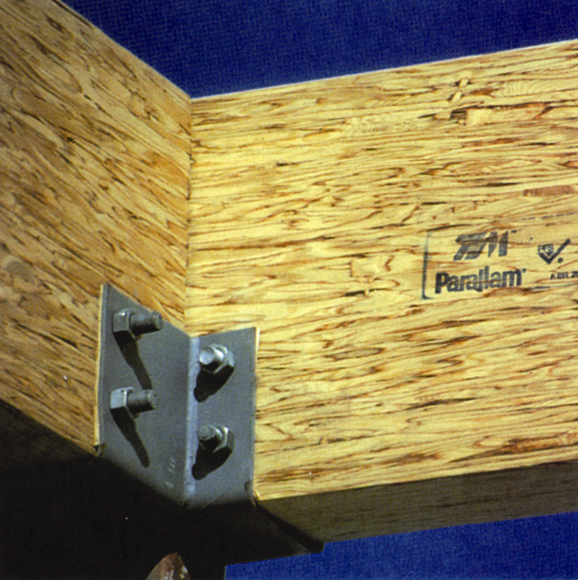
Parallel Strand Lumber (PSL)
Widths from 1-3/4" to 7"
Two plies of 2-11/16" members match typical 5-1/2" wall
Lengths up to 66'
Eliminates need for built-up beams
Alpine Structures

Slide 38
Laminated Veneer Lumber (LVL)
Veneers stacked parallel to each other
Used for headers, beams, joists, columns, and flanges for wood I-beams
All plies parallel to provide maximum strength
Woods of choice are southern yellow pine and Douglas fir

Slide 39
Laminated Veneer Lumber (LVL)
Advantages:
High strength allows long spans
Can be built-up on site to form larger members
Disadvantages:
More expensive than solid lumber
Lower moisture content than solid lumber
Must be sized for specific load conditions

Slide 40
Laminated Veneer Lumber (LVL)
1-3/4" billet most common
Use individually for joists or combined to form headers or beams
Depths from 5-1/2" to 18", lengths up to 66'
Should not be mixed with solid lumber in same floor assembly
Beams should not be drilled

Slide 41
Glue-Laminated Lumber
Also called glulam beams
1x or 2x lumber glued in stacks to desired shape and size
Virtually any length or depth can be produced
Manufactured to national standard
Grades available: Framing, industrial, architectural, premium

Slide 42
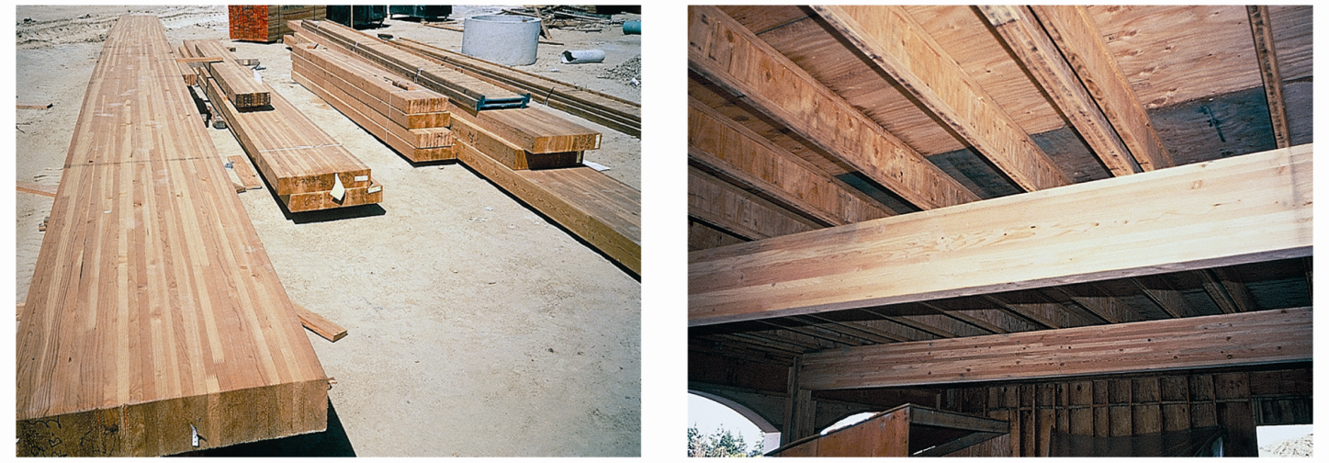
Glue-Laminated Lumber
The Engineered Wood Association

Slide 43
Glue-Laminated Lumber
Advantages:
High strength
Available either straight or cambered
Dimensionally stable and attractive
Disadvantages:
Expensive
Requires special handling and storage
Requires special equipment to handle

Slide 44
Installation of Glue-Laminated Lumber
Technical support generally required
Manufacturers provide span charts, installation details, technical assistance
Special connectors required

Slide 45
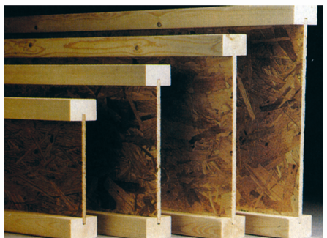
Wood I-Joists
2 x 4 machined-stressed lumber or LVL
Webs usually made from 3/8" OSB
Variety of flange widths, depths, lengths
Boise Cascade Corporation

Slide 46
Wood I-Joists
Advantages:
Speed of construction
Knockout holes for plumbing and electrical cable
Dimensionally stable and straight
Disadvantages:
Require more effort to cut
Not universally accepted

Slide 47
Wood I-Joists
Installation similar to traditional floor joists or rafters
Should not be mixed with solid lumber in same assembly
Web stiffeners or blocks normally used at bearing points

Slide 48
Post and Beam Construction
Posts, beams, and planks as framing members
Spaced farther apart than conventional framing members
Posts carry most weight
Curtain walls allow for wide glass, no headers
Foundation is continuous wall or series of piers on which each post is located

Slide 49
Post and Beam Construction
Check local codes for post size requirements
Beam types include solid, laminated, steel-reinforced, plywood box
Spacing and span determined by size and type of materials and load to be supported
Beam placement systems include longitudinal method and transverse method

Slide 50
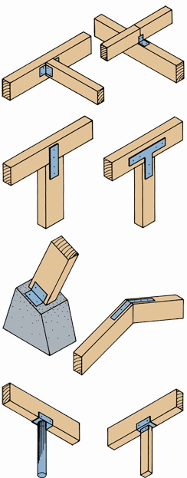
Post and Beam Construction
Metal fasteners used to connect large beam segments
Goodheart-Willcox Publisher

Slide 51
Respecting Diversity
Employability
Characteristics that vary from person to person is known as diversity
Being able to work with a diverse group is an important job skill
Getting to know those who differ from us makes us less likely to subject others to generalizations or preconceived biases we may have

