Slide 2
Chapter 21
Doors and Windows

Slide 3
Objectives
Compare the types of doors used in a residential dwelling.
Describe the various types of windows used in residential construction.
Draw proper door and window symbols on a typical floor plan.
Prepare window and door schedules.

Slide 4
Introduction
Doors and windows:
Shield an opening from the elements
Add decoration and expand visibility
Emphasize the overall design
Provide light and ventilation
Window manufacturers provide CADD packages to help in specifying and drawing their windows
Most contain window and door symbols

Slide 5
Interior and Exterior Doors
Two broad classes:
Interior
Exterior
Doors also grouped according to method of construction, uses, function, or location

Slide 6
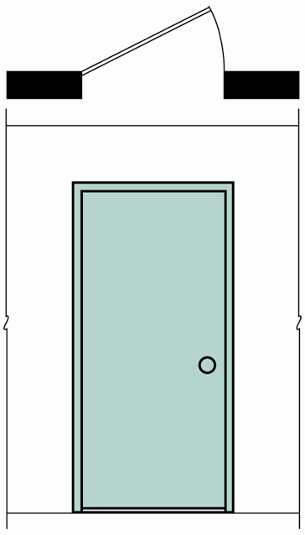
Flush Doors
Smooth on both sides
Made of wood
Standard thickness 1-3/8"
Hollow-core doors with wood frame
Widths, 2'-0" to 3'-0"
Elevation with plan view symbol
Goodheart-Willcox Publisher

Slide 7
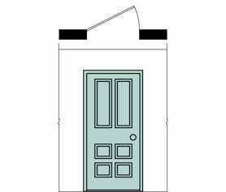
Panel Doors
Frame and panel construction
Vertical frame members called stiles
Horizontal frame members called rails
Panels of wood, glass, metal, other materials
Frame of white pine, other woods, or plastic
Goodheart-Willcox Publisher

Slide 8
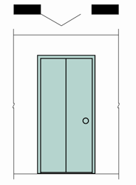
Bifold Doors
Two-part, hinged in center
Supported with conventional hinges or pivot hinge
Flush, paneled, or louvered
Popular as closet doors
Goodheart-Willcox Publisher

Slide 9
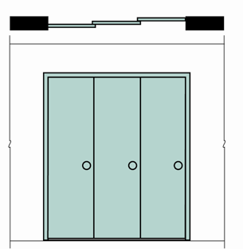
Sliding Doors
Multiple doors to close opening
Popular as closet doors
Hung from track on head jamb
Door pulls recessed
Glides on floor prevent swinging
Flush, panel, or louvered
Tend to warp because not restrained by hinges
Goodheart-Willcox Publisher

Slide 10
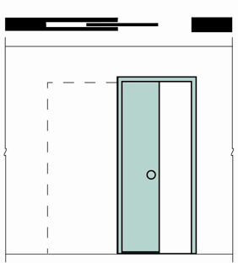
Pocket Doors
Hung from track mounted on head jamb
Flush or panel
One door closes opening
Rest in wall pocket when opened
Used between rooms
Require no wall space when opened
Pocket cavity problems for outlets or cabinets
Goodheart-Willcox Publisher

Slide 11
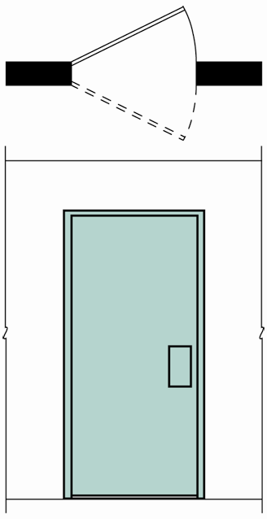
Double-Action Doors
Hinged so door swings through 180° arc
Mounted in center of side jamb
Generally used between rooms with heavy traffic
Single or double doors
Panel, flush, or louvered style
Goodheart-Willcox Publisher

Slide 12
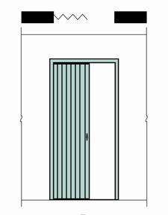
Accordion Doors
Close large openings
Require little space when open
Variety of materials and designs
Hinged panels, large folded piece of fabric, or other material
Mounted on track on head jamb
Goodheart-Willcox Publisher

Slide 13
Exterior Doors
Usually solid core, thicker than interior doors
Styles include flush, panel, swinging and sliding glass, Dutch, French, garage
Dutch doors and French doors also used as interior doors

Slide 14
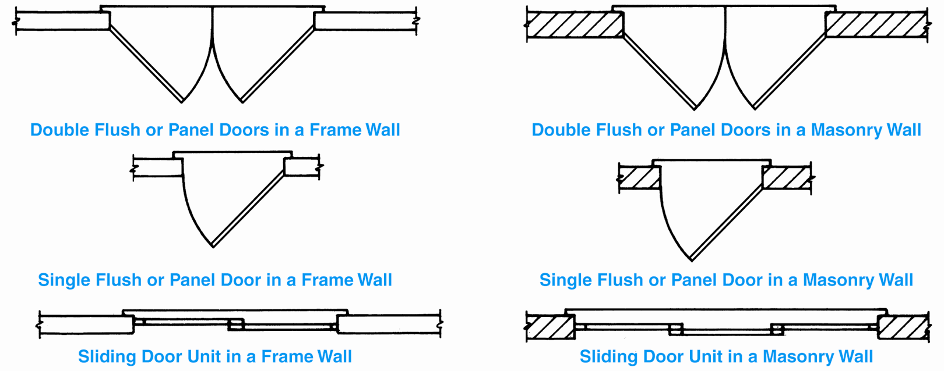
Exterior Doors
Standard plan view symbols of exterior doors
Goodheart-Willcox Publisher

Slide 15
Flush Doors (Exterior)
1-3/4" thick
Made from birch, mahogany, oak, other woods, metal, reinforced fiberglass
Glass, moldings, other decorative millwork added to enhance appearance

Slide 16
Panel Doors (Exterior)
Available in many styles
Made of white pine, oak, fir, other woods, metal, and reinforced fiberglass
Produced in same sizes as exterior flush doors

Slide 17
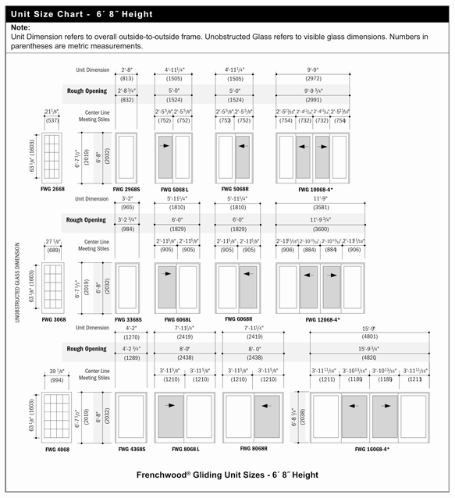
Sliding and Swinging Glass Doors
Made of wood or metal
Typical sizes shown here
Courtesy Andersen Windows Inc.

Slide 18
Dutch Doors
Upper and lower sections
Upper section operates independently of lower section, allowing for light and ventilation
Usually an exterior
May be used between kitchen and dining room

Slide 19
French Doors
Panel doors in which panels are glass
Popular for patio or terrace doors
Used to close off rooms that are used less often than other rooms

Slide 20
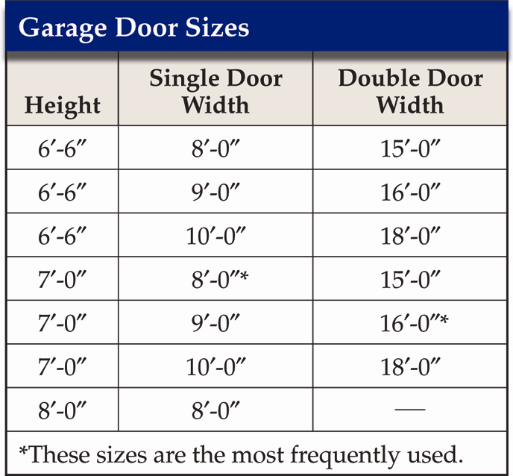
Garage Doors Sizes
Overhead sectional door most popular
Available in wood, metal, plastics
Automatic garage door opener installation requires additional headroom and electrical outlet be provided
Goodheart-Willcox Publisher

Slide 21
Specifying Doors
Each door in residential plan should appear in door schedule
Place door schedule on sheet with floor plan or elevations, or in details section of set of drawings

Slide 22
Typical Door Schedule
Goodheart-Willcox Publisher

Slide 23
Door Details
Interior and exterior doors placed in door jamb
Jambs available as prehung units
Rough opening for interior doors framed 3" more than door height, 2-1/2" more than door width
Casing covers space between jamb and framing
Casing in masonry wall called brick mold
Drip cap in frame construction sheds water

Slide 24
Door Jamb
Goodheart-Willcox Publisher

Slide 25
Door Details
Sill at bottom of door opening
Door and window construction details drawn in section through jambs and sill
Construction details for exterior sliding door units more complicated than other doors
Secure specifications from manufacturer to ensure accuracy

Slide 26
Windows
Admit light from outside
Provide fresh air and ventilation
Help create an atmosphere inside by framing exterior views
Add detail, balance, and design to the exterior of the house

Slide 27
Windows and Lighting
Glass area: At least 20% of room’s floor area
Face principal windows south
One large window opening creates less brightness contrast than several small openings

Slide 28
Windows and Lighting
Place windows on more than one wall for better light distribution
Windows placed high on a wall provide more light penetration into room
Select window shape that provides type of light distribution desired

Slide 29
Windows and Ventilation
Openings for ventilation should be at least 10% of the floor area
Take advantage of natural breezes
Locate windows to achieve best movement of air across a room
Avoid furniture interference with airflow

Slide 30
Selecting Windows for a View
Large fixed windows provide clear viewing
Window divisions should be thin to minimize obstructions
Furniture, room arrangement, and view should be considerations for sill height

Slide 31
Window Types
Windows are made differently, depending on what material they are made from
Construction differs by manufacturer
Obtain window specs from manufacturer
Commonly used windows include sliding, swinging, fixed, combination

Slide 32
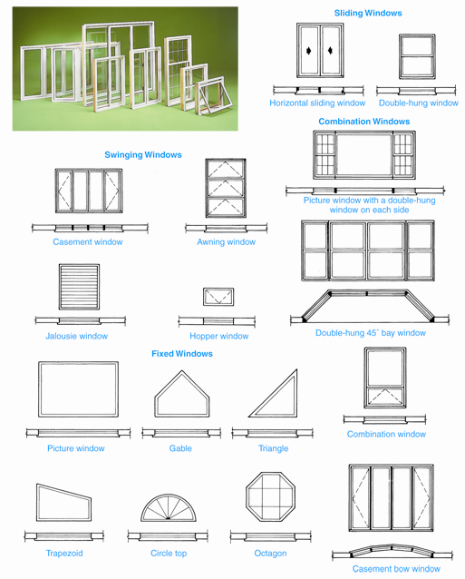
Window Types
Goodheart-Willcox Publisher

Slide 33
Window Selection Criteria
The function(s) to be performed
Architectural style of the structure
Construction considerations
Building codes
Personal taste

Slide 34
Sliding Windows
Double-hung windows
Sashes, muntins, mullions
Rough opening, sash opening, glass size
Sections drawn at head jamb, side jamb, sill
Section of support mullion also drawn for multiple windows placed together as a unit

Slide 35
Double-Hung Window Sizes
Courtesy Andersen Windows Inc.

Slide 36
Sliding Windows
Horizontal sliding windows
Two sashes
Rollers not required unless window is large

Slide 37
Horizontal Sliding Window Sizes
Courtesy Andersen Windows Inc.

Slide 38
Energy-Efficient Windows
Green Architecture
Some windows made of acrylic, not glass
Acrylic 20% more energy efficient, more flexible
Acrylic is made from petroleum products, so it is not sustainable and is more difficult to recycle than glass
Glass is still material of choice for windows
Energy efficiency improved with coatings, seal between glass and frame, lamination to improve wind resistance

Slide 39
Swinging Windows
Casement window hinged at side, swings outward
Awning window hinged at top, swings out at angle
Hopper window hinged at bottom, swings inward
Jalousie window has series of horizontal slats that operate in unison

Slide 40
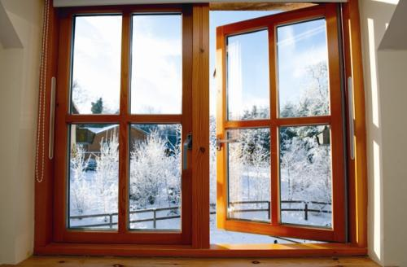
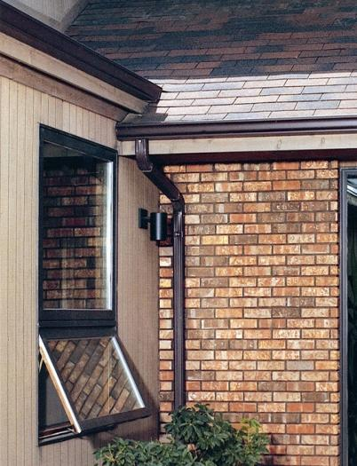
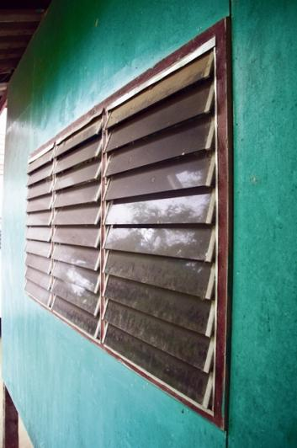
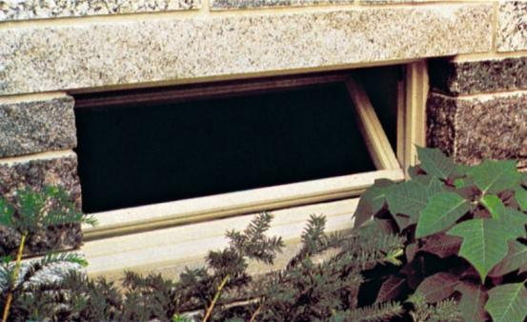
Swinging Windows
Carado; Ctatiana/Shutterstock.com; Courtesy Anderson Windows Inc; Dontree/Shutterstock.com

Slide 41
Fixed Windows
Provide a view and admit light
Do not open, not used for ventilation
Usually custom-made
Examples include picture windows, circle top windows, and special shapes

Slide 42
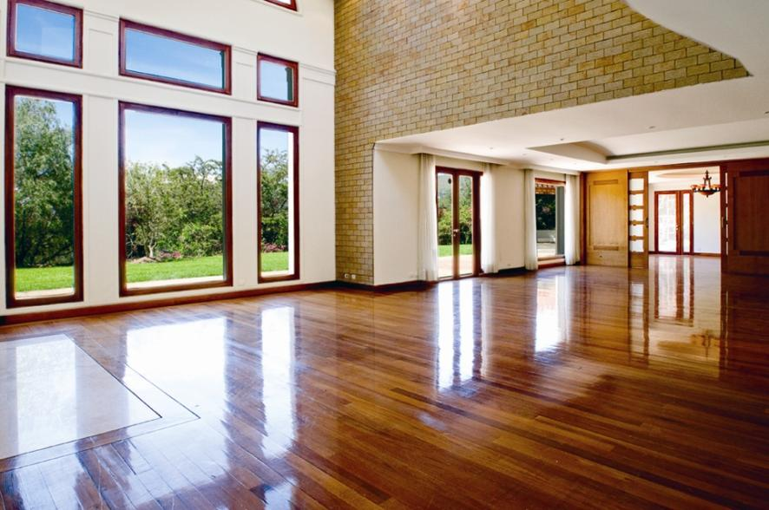
Picture Windows
Large, generally frame a view
Often center unit of group of regular windows
Santiago Cornejo/Shutterstock.com

Slide 43
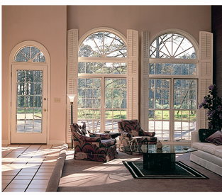
Circle Top Windows
Installed above another window
Quarter circles, half circles, ellipses, full circles
Peachtree Doors, Inc.

Slide 44
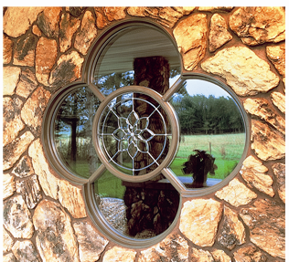
Special-Shape Windows
Fixed window
Made-to-order
Combined with other windows, creates dramatic effect
Weather Shield Mfg., Inc.

Slide 45
Combination Windows
Mixture of two or more windows types
Bay windows
Bow windows
Picture windows combined with swinging or sliding windows
Bay and bow windows project out from structure

Slide 46
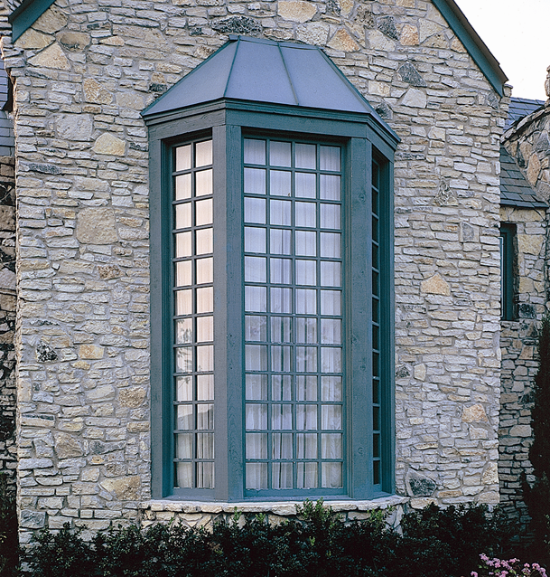
Bay Windows
Usually double-hung windows on either side of fixed center window
Side windows placed 45° to exterior wall
Box bay window or garden window
Marvin Windows and Doors

Slide 47
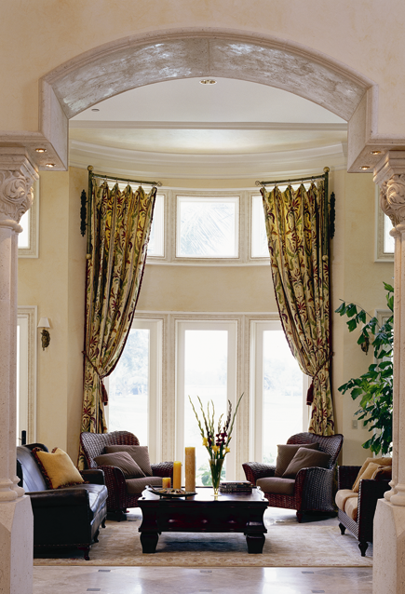
Bow Windows
Series of similar-style windows positioned to form arc that extends out from wall
Four to seven common units
Pozzi Wood Windows

Slide 48
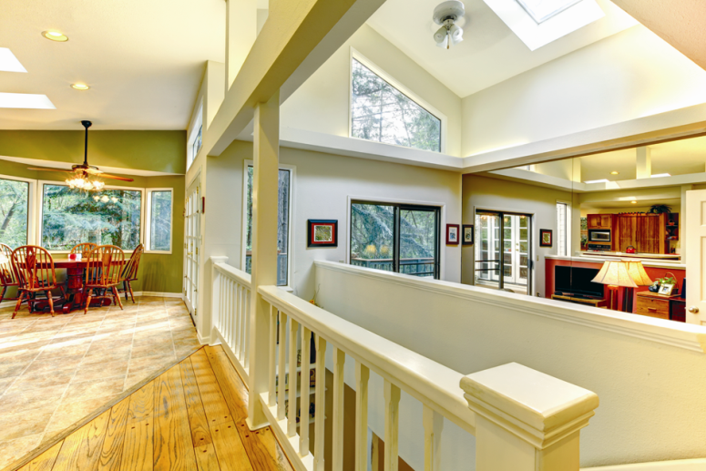
Skylights and Clerestory Windows
Admit light where little or no natural light
Skylights are located on roof
Clerestory windows placed high on wall
Iriana Shiyan/Shutterstock.com

Slide 49
Window Schedules
Provide info about all windows in structure
Type of window and size
Identifying symbol
Manufacturer’s number
Installation
Placed on floor plan, elevation, other drawings

Slide 50
Typical Window Schedule
Goodheart-Willcox Publisher

Slide 51
Team Protocol
Employability
Set of unspoken rules that dictate behavior
Clearly state purpose, have clear set of goals, create welcoming atmosphere, encourage participation and expression of ideas, and lead members to general consensus
Members should communicate freely with others, support other members’ ideas, avoid blame, be team players, listen, and get involved

