Slide 2
Chapter 22
Building Sections

Slide 3
Objectives
Explain the purposes of building sections.
Describe the three main types of building sections.
Explain how to identify the location of a building section.
List information that must be obtained before a building section can be drawn.
Draft a full section using either manual or CADD techniques.

Slide 4
Building Sections
Building sections
  Vertical “cuts” or “slices” through a structure
  Illustrate type of foundation, wall, and roof construction
  Know when and how to include building sections in drawings
  Requires understanding of building materials, their uses, and what type of view is needed

Slide 5
Purpose of Building Sections
Informs contractor or builder of special or unconventional construction methods or techniques
Provides information about size, floor heights
Shows specific materials and fasteners to be used

Slide 6
Types of Building Sections
Full building section
Partial building section
Wall section

Slide 7
Full Building Section
Goodheart-Willcox Publisher

Slide 8
Full Building Section
Also called cross section
Shows relationship among interior spaces
Specifies overall height relationships
General building materials used
Drawn at same scale as floor plan
Foundation information

Slide 9
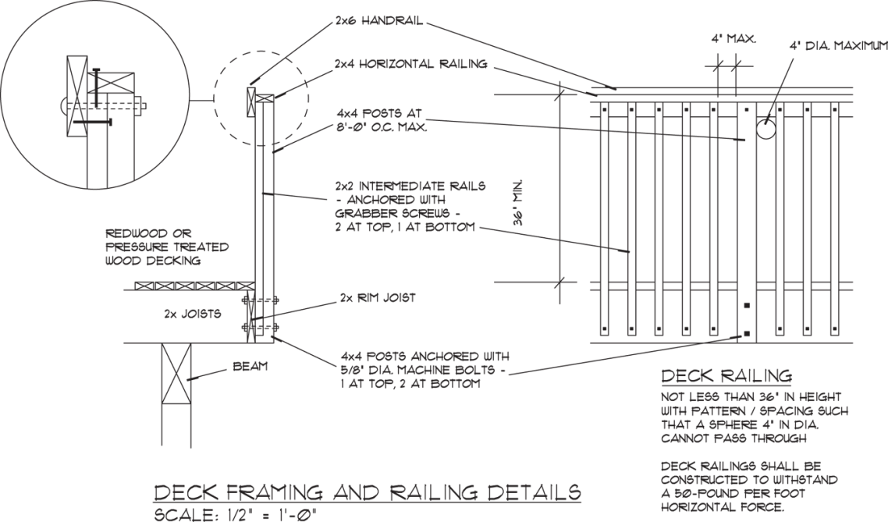
Full Building Section
Deck framing and railing details
Lizz Layman

Slide 10
Partial Building Section
Goodheart-Willcox Publisher

Slide 11
Partial Building Section
Shows part of structure in more detail
Cuts through half or more of structure, but not its entire length
Drawn at a larger scale—usually 3/8″ = 1′-0″ or larger

Slide 12
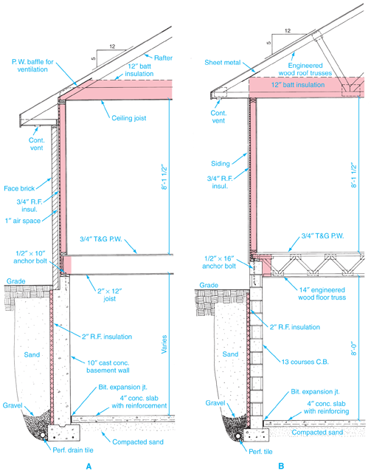
Wall Section
Goodheart-Willcox Publisher

Slide 13
Wall Section
Cuts through only one (typically exterior) wall
Shows foundation system, wall system, roof system at one location in structure
Shows more specific detail than any other type of building section
Usually drawn at a 3/4″ = 1′-0″ or larger scale

Slide 14
Typical and Specific Sections
Typical section
  Represents features or sizes that are used in many different places in structure
Specific section
  Shows feature, method, or technique that is used only once

Slide 15
Specifying Building Section Location
Location of each section in set of working drawings is shown on floor plan
Cutting-plane lines
  Drawn across plan to identify location of building section

Slide 16
Identifying Sections
First section is labeled A–A
Second section is labeled B–B
Actual section drawings are labeled Section A–A, Section B–B, and so on

Slide 17
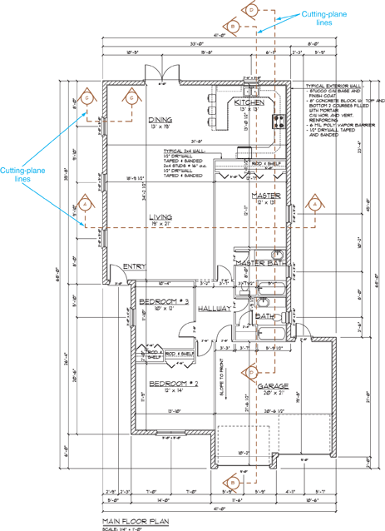
Building Sections
Goodheart-Willcox Publisher

Slide 18
Longitudinal and Transverse Sections
Longitudinal building section
  Runs across the longest dimension of building
Transverse building section
  Perpendicular to longitudinal building section

Slide 19
Sustainability Plan
Green Architecture
Guidelines and procedures
Helps organization use, develop, and protect resources in a way that meets needs without harming environment
Communication and education within company are needed to meet these goals

Slide 20
Preparing to Draw Building Sections
Questions to be answered include:
  Foundation information?
  Existing grade?
  Heights from finished floor to finished ceilings?
  Rough openings of doors and windows?
  What type of roof construction?
  What kind of exterior materials?
  What type of soffit?
  Special fasteners?

Slide 21
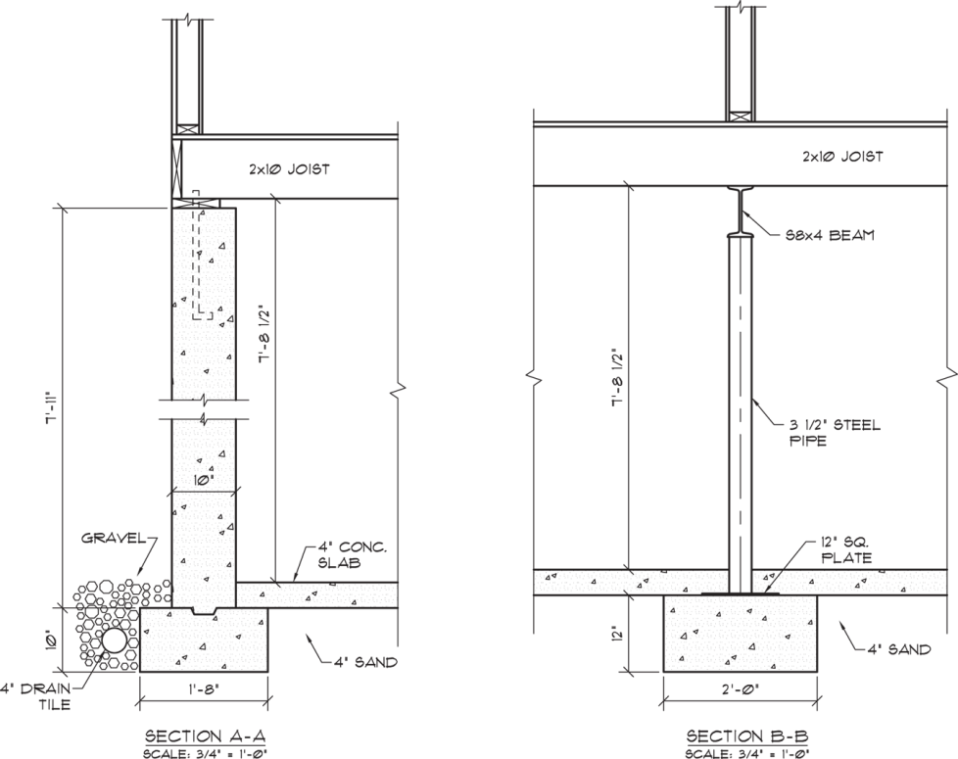
Foundation Detail Sections
Goodheart-Willcox Publisher

Slide 22
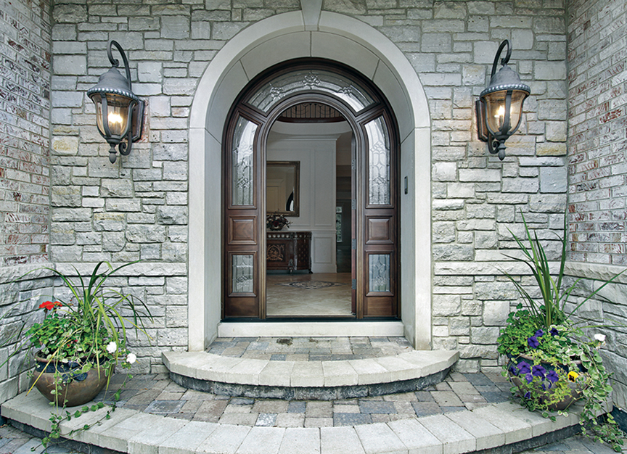
Standard Framing
pics721/Shutterstock.com

Slide 23
Manual Drafting:
Full Building Section
Collect essential size information
Choose scale
Layout and draw footings, foundation wall, and floor slab; position and draw grade line; locate and show portion of basement slab
After constructing foundation wall, locate and draw floor joists or trusses and wall and roof structures

Slide 24
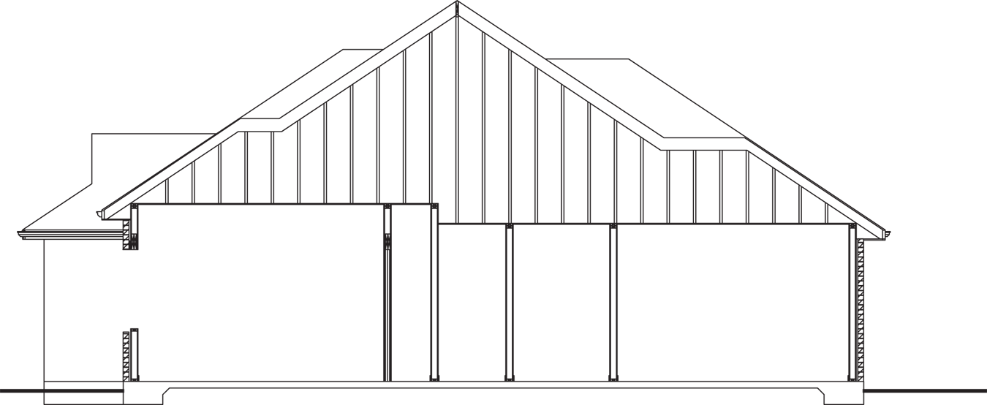
Manual Drafting:
Full Building Section
Goodheart-Willcox Publisher

Slide 25
Manual Drafting: Full Building Section
5. Add details and material symbols
6. Add dimensions and notes
7. Add title and scale
8. Review your work

Slide 26
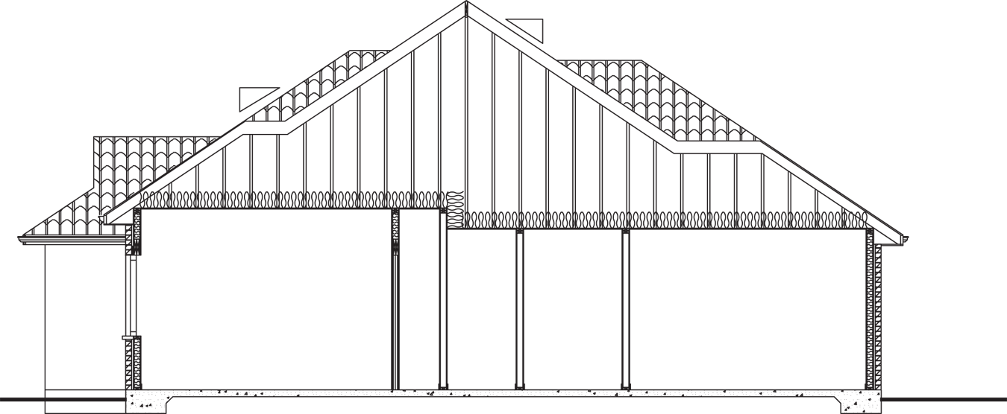
Manual Drafting: Full Building Section
Goodheart-Willcox Publisher

Slide 27
CADD: Full Building Section
Collect essential size information
Select layer for footing and foundation wall or copy floor plan and foundation plan into new drawing; draw footing and foundation wall; locate and draw basement slab; position and draw grade line

Slide 28
CADD: Full Building Section
3. Locate and draw floor joists or trusses and wall and roof structures
  Use actual sizes rather than nominal sizes
Add details and hatch patterns
Add dimensions and notes
Add scale and title on appropriate layers
Review your work

Slide 29
CADD: Full Building
Goodheart-Willcox Publisher

Slide 30
Parametric Modeling:
Creating a Section View
1. Access the SECTION command in the floor plan view and select the appropriate view type to create a building section
2. Adjust the section boundary establishing the extents of the section view
3. Change the default name of the section view

Slide 31
Parametric Modeling:
Creating a Section View
4. Open the section view and change the view scale to the appropriate scale
5. If necessary, adjust the display of features below grade
6. In certain views, you may want to add features where necessary to show more detail

Slide 32
Parametric Modeling:
Creating a Section View
7. Add dimensions and notes
8. Create a new sheet for the section view
9. When you are finished, print or plot the sheet

Slide 33
Using Social Media
Employability
Can be used to reach current customers and find new ones
Return messages from those who have taken time to respond to your communication
Use good judgment and represent the organization in a professional manner

