Slide 2
Chapter 23
Elevations

Slide 3
Objectives
List features that should be included on an exterior elevation.
Describe the placement of walls, windows, and doors on an elevation.
Explain how to show roof features on an elevation.
Identify the dimensions commonly shown on elevations.
Draw an exterior elevation that demonstrates proper techniques.

Slide 4
Introduction to Elevations
Elevation
  Orthographic projection drawing of one side of building
  Gives vertical dimensions
  Shows exterior materials

Slide 5
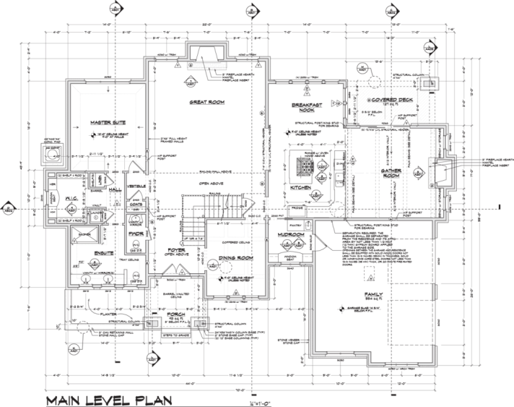
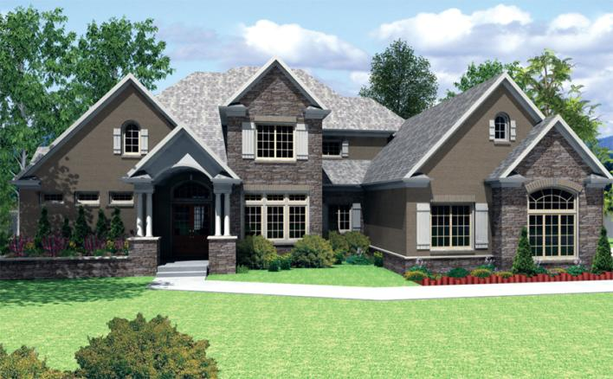
Elevation
This rendering shows a typical residence
Martin Drafting and Design, Inc.

Slide 6
Elevation Identification
Four elevations—one for each side of house
Identified by structure side or compass points
Martin Drafting and Design, Inc.

Slide 7
Grade Lines, Floors, and Ceilings
Grade line is reference point for most elevations
Site plan shows the existing grade
Draw all features below grade as hidden lines
Foundation walls, footings, and window wells

Slide 8
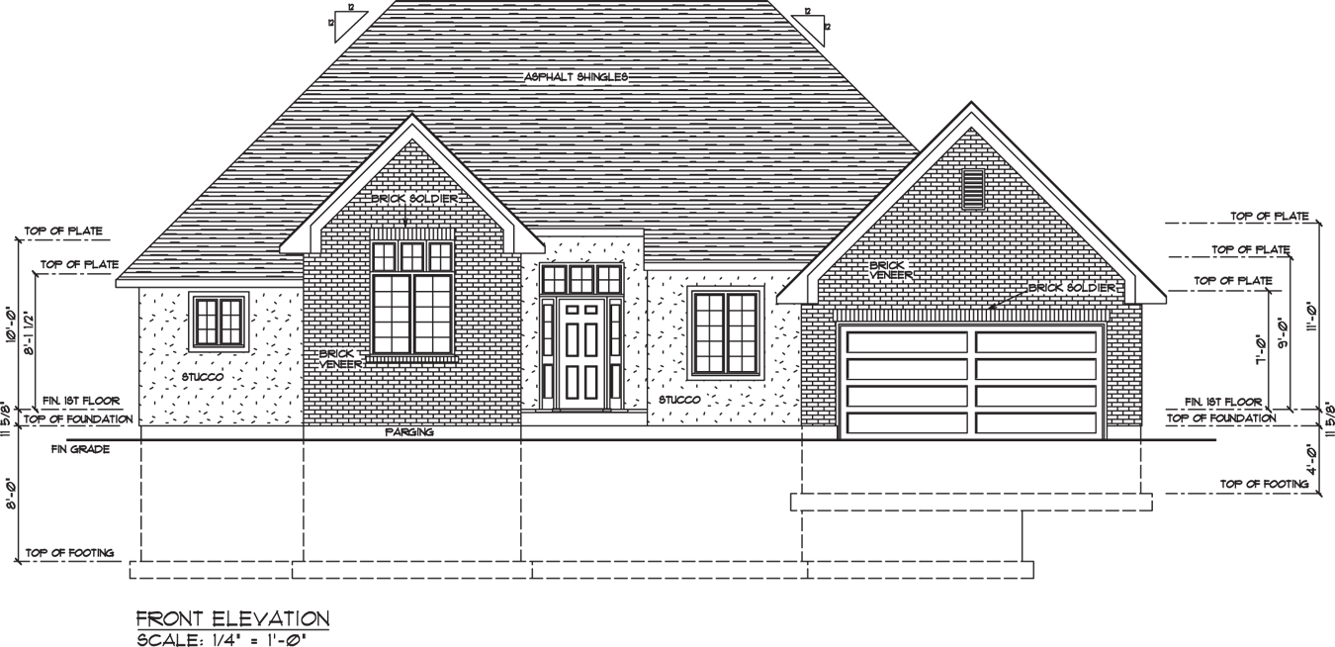
Grade Lines, Floors, and Ceilings
You can see the finished grade line and other features
Goodheart-Willcox Publisher

Slide 9
Floor-to-Ceiling Height
Two methods of representing floor-to-ceiling height
  Indicate distance from finished floor to finished ceiling
  Show construction dimension

Slide 10
Walls, Windows, and Doors
Show visible wall corners as object lines
Draw a wall section to identify vertical heights needed for drawing
Include windows and doors that are visible on exterior wall
Tops of windows and doors are usually 6'-10" from the top of the subfloor

Slide 11
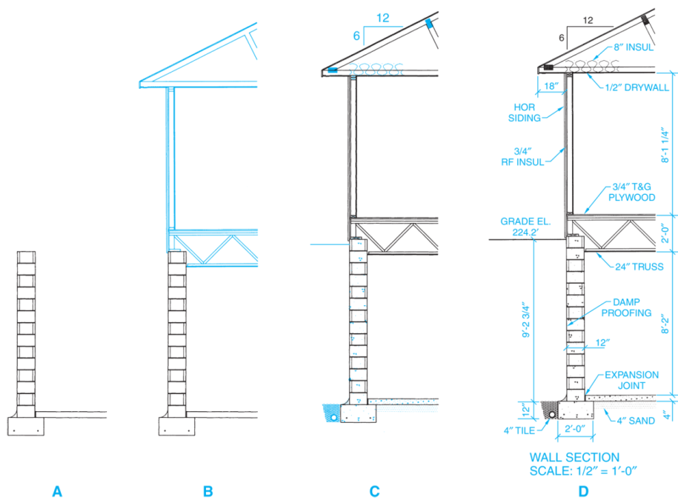
Walls, Windows, and Doors
Basic process for drawing wall section
Goodheart-Willcox Publisher

Slide 12
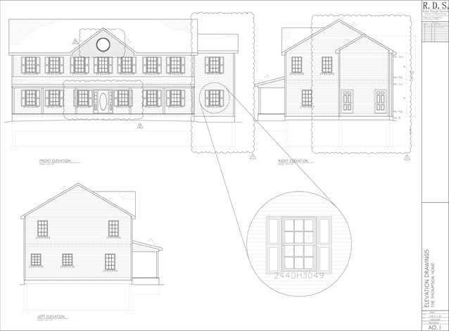
Walls, Windows, and Doors
In this project, all windows will be replaced
Rob Potts

Slide 13
Sustainable Exteriors
Green Architecture
Eco-friendly stucco made entirely from natural limestone
Nontoxic paint
Sustainable alternative finishes save money in the long run and preserve environment

Slide 14
Roof Features
Shown on an elevation drawing
  Roof style and pitch
  Chimney height and size
Draw gable ends first to determine roof height—highest section first
Show chimney flashing, roof covering material, and gable ventilators

Slide 15
Dimensions, Notes, Symbols
Dimensions on elevations are mainly height dimensions
Notes provide additional information
Frequently used symbols:
  Roof pitch symbol
  Exterior materials
  Window swing symbols
  Cutting-plane lines

Slide 16
Manual Drafting: Elevations
1. Draw a section through the wall to be represented by the elevation. Section should be 1/4" = 1'-0" scale. Draw a section for each different type of wall.
2. Place floor plan above space where elevations are to be drawn.

Slide 17
Manual Drafting: Elevations
Steps 1 and 2
Goodheart-Willcox Publisher

Slide 18
Manual Drafting: Elevations
3. Project heights of features on section drawing to space where elevation is to be drawn.
4. Project the features from the floor plan to the space where the elevation is to be drawn.

Slide 19
Manual Drafting: Elevations
Steps 3 and 4
Goodheart-Willcox Publisher

Slide 20
Manual Drafting: Elevations
5. Darken each feature and remove construction lines. Check overall design.
6. Add details, such as railings, window muntins, trim, window wells, and gable ventilators. Check manufacturer’s literature.

Slide 21
Manual Drafting: Elevations
Steps 5 and 6
Goodheart-Willcox Publisher

Slide 22
Manual Drafting: Elevations
7. Add dimensions, notes, and symbols. Draw material symbols last.
8. Add title and scale.
9. Check drawing for completeness.

Slide 23
Manual Drafting: Elevations
Steps 7, 8, and 9
Goodheart-Willcox Publisher

Slide 24
CADD: Elevations
1. Draw typical wall section to provide height measurements. Draw objects for section at actual size.
2. Place copy of floor plan above space where elevation will be drawn. Place side of floor plan that will be shown in elevation facing area where elevation will be drawn.

Slide 25
CADD: Elevations
3. Project features to be drawn on elevation from floor plan. Project one or more elements at a time. Projection lines should be on separate layer.
4. Locate foundation wall, footings, and grade line heights on elevation. These will be hidden lines except for grade line. Use separate layers.

Slide 26
CADD: Elevations
5. Locate wall height and roof lines on elevation. Draw exterior walls above grade and roof. Exterior wall lines should have their own layer.
6. Locate height of windows, doors, and other features. Use symbols library for complex symbols.

Slide 27
CADD: Elevations
7. Add dimensions and notes.
8. Add material symbols (hatch patterns).
9. Add scale and title.
10. Hide or turn off layer(s) containing floor plan copy and wall section.
11. Follow same procedure to create elevations for remaining sides of house.

Slide 28
Completed Front Elevation
Goodheart-Willcox Publisher

Slide 29
Parametric Modeling:
Creating an Elevation View
1. Access the ELEVATION command in the floor plan view, select the appropriate view type to create an exterior or interior elevation
2. Adjust the boundary establishing the extents of the elevation view
3. Change default name of elevation view

Slide 30
Parametric Modeling:
Creating an Elevation View
4. Open the elevation view and change the view scale to the appropriate scale
5. If necessary, adjust the display of lines below grade
6. Adjust the display of levels as needed
7. Add dimensions and notes

Slide 31
Parametric Modeling:
Creating an Elevation View
8. Create a new sheet for elevation view
9. Look over your work to be sure that you are finished
10. Follow same procedure to create elevations for remaining sides of the house

Slide 32
Coping with Stress
Employability
Changes can cause stress
Stress can affect work performance
Understand cause of your stress
Think about ways to handle it
Keep log to determine what are stress triggers

