Slide 2
Chapter 24
Stair Details

Slide 3
Objectives
Identify the basic types and shapes of stairways.
Describe the basic parts of a stairway.
Design a stairway for a residential structure.
Perform stair calculations for a residential stairway.
Draw a structural detail for a stairway.

Slide 4
Introduction
A stairway is a series of steps between levels of a building
Prime design considerations are safety and easy ascent and descent

Slide 5
Types of Stairs
Main stairs
Service stairs
Stairways can also be enclosed or open

Slide 6
Stairway Configurations
Straight run stairs
L stairs
Double-L stairs
U stairs
Winder stairs
Spiral stairs
Circular stairs

Slide 7
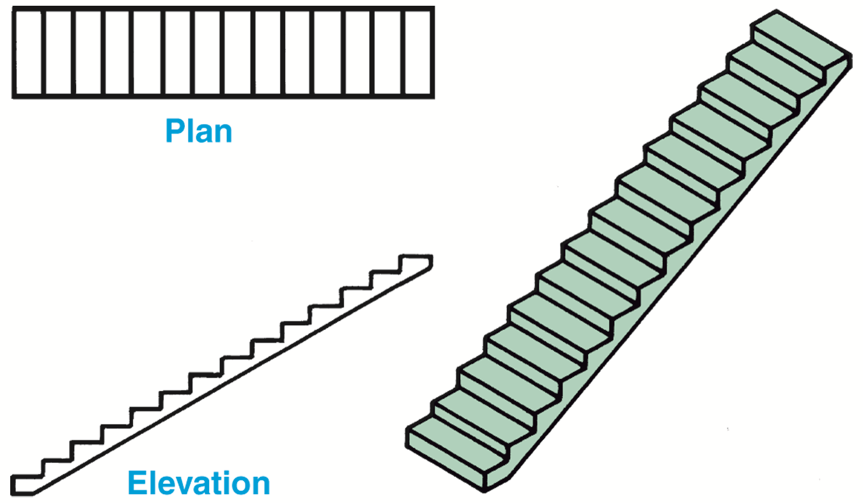
Straight Run Stairs
No turns, most common in home construction
Not as expensive to construct as others
Require a long, open space
Goodheart-Willcox Publisher

Slide 8
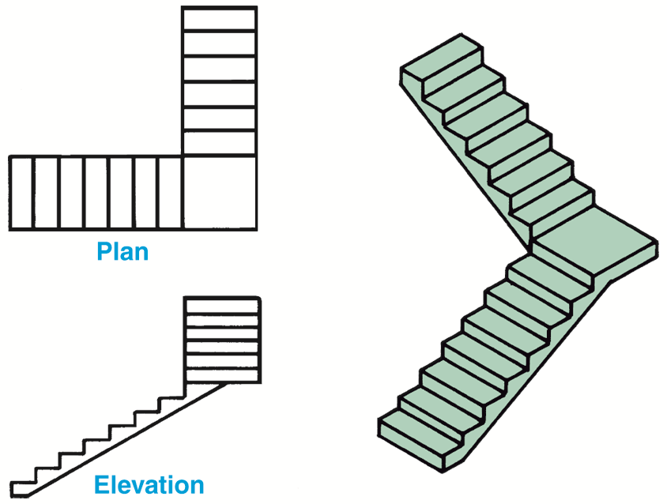
L Stairs
One landing and one 90° turn
Long L is landing near top or bottom of stairway
Used when not enough space for straight run
Goodheart-Willcox Publisher

Slide 9
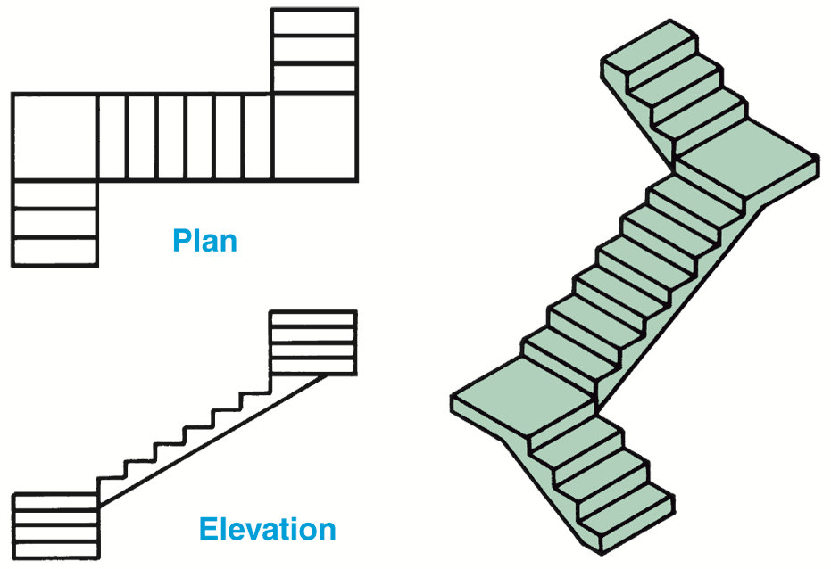
Double-L Stairs
Two 90° turns and two landings; not U shaped
Used when no space for straight or L stairs
Expensive to build
Goodheart-Willcox Publisher

Slide 10
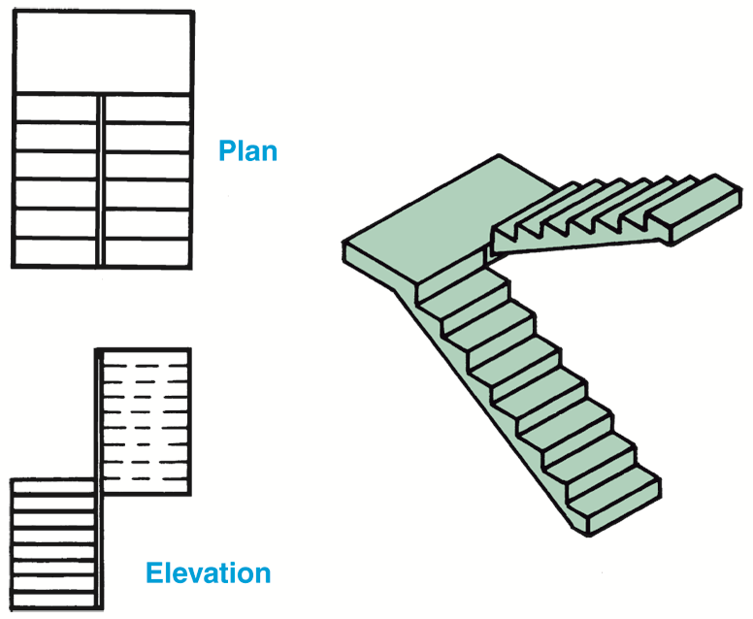
U Stairs
Two flights of stairs, parallel to each other with landing in between
Narrow or wide
Narrow U stairs have little or no space between flights
Wide U stairs have a well hole between flights
Goodheart-Willcox Publisher

Slide 11
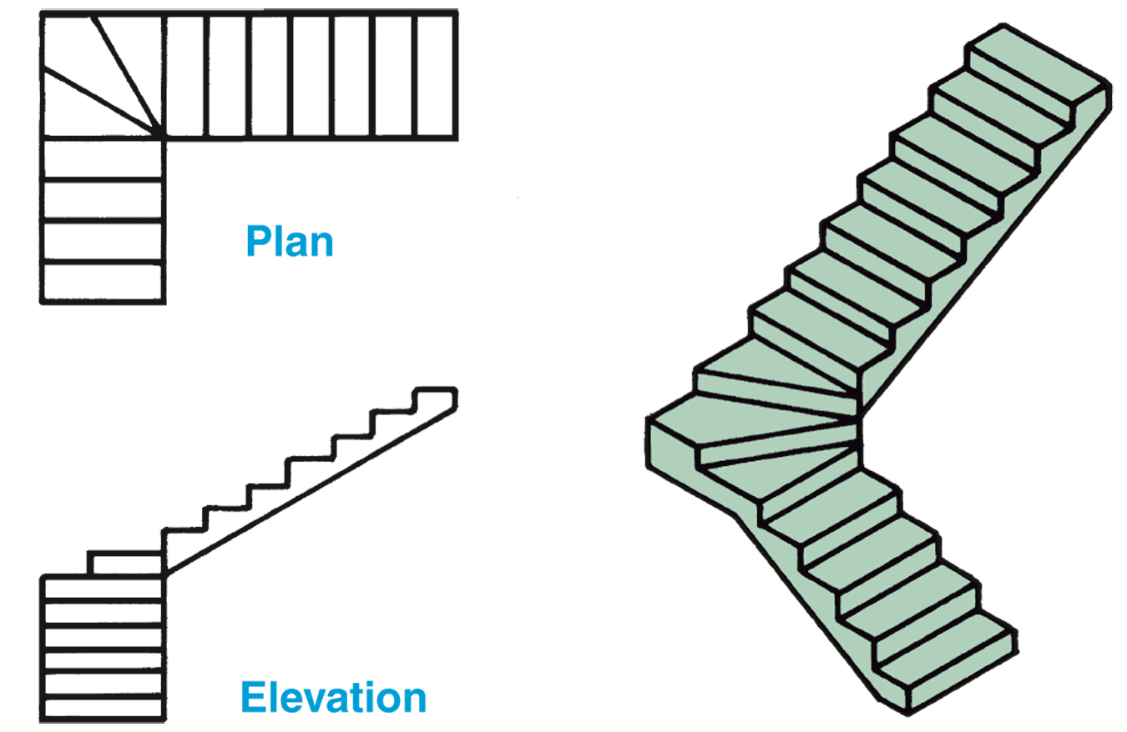
Winder Stairs
Pie-shaped steps that replace landing
Used when no space for L, double-L, U stairs
Not as safe as other stairs, avoid if possible
Goodheart-Willcox Publisher

Slide 12
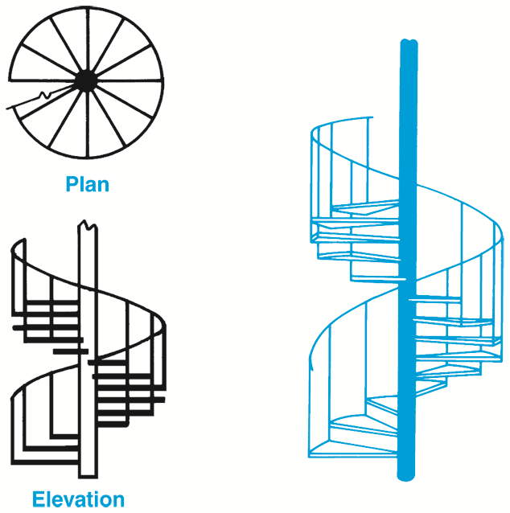
Spiral Stairs
Form a circle about a center point
Used where little space is available
Can be decorative
Not very safe
Goodheart-Willcox Publisher

Slide 13
Circular Stairs
Curved, with trapezoidal steps
Custom-made, require space, expensive
Jakrit Jiraratwaro/Shutterstock.com

Slide 14
Parts of a Stairway
Treads
Risers
Stringers

Slide 15
Stringers
Main supporting members of stairway
Common types: Plain stringers, housed stringers
Two stringers usually sufficient
Wider stairs require third stringer

Slide 16
Stringers
Plain stringers
Cut from 2 x 12 straight-grain fir
Treads and risers nailed directly to stringers
Housed stringers
Made from finished lumber
Grooves routed in stringers hold treads and risers

Slide 17
Stringers
Goodheart-Willcox Publisher

Slide 18
Treads and Risers
Standard treads are 1-1/4" thick oak and 10-1/2" and 11-1/2" wide
Nosing not included in calculations
Risers 3/4" thick actual size, widths vary based on slope of stairs
Ideal riser height between 7" and 7-5/8"

Slide 19
Bamboo Stairs
Green Architecture
Highly sustainable, have natural beauty
Some manufacturing methods for bamboo introduce volatile organic compounds (VOCs)
Transportation of bamboo is environmental issue
Some farmers use inorganic pesticides, fertilizers
Choose supplier who can guarantee sustainability of product

Slide 20
Stair Design
Properly designed and constructed stairs must support weight required by application
Stairs must be wide enough to provide easy passage of people and furniture
Proper slope is between 30° and 35°

Slide 21
Slope of a Stairway
Stairway slope depends on tread and riser size and rise and run
Total rise
Total run
Slope specified in degrees or as ratio of rise to run or riser to tread

Slide 22
Slope of a Stairway
Calculating slope of stairs
Slope should be between 30° and 35°
Sum of two risers and one tread should equal 25"
Riser height multiplied by tread width should equal approximately 75"
Sum of one riser, and one tread should equal 17" to 18"

Slide 23
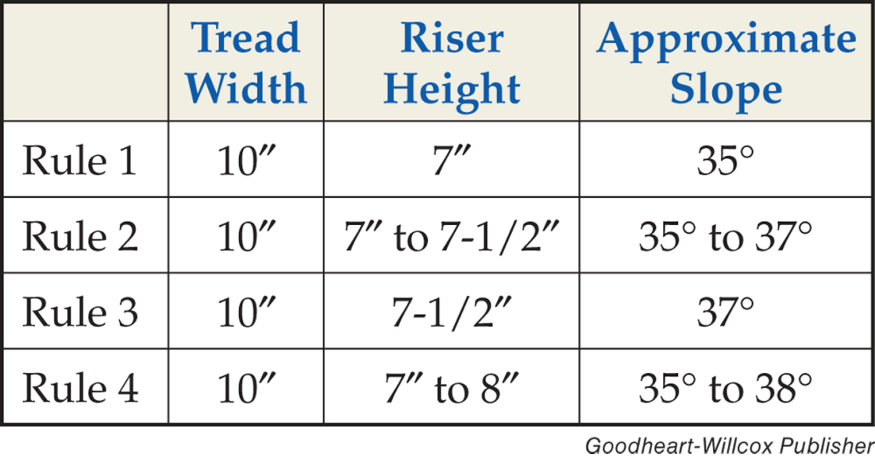
Slope of a Stairway
Riser height less than 7" considered too short
7:10 ratio, 35° ideal

Slide 24
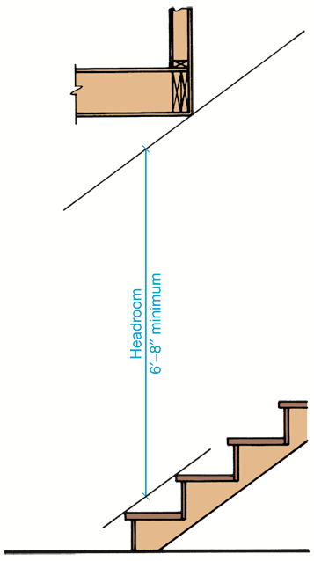
Headroom
Shortest clear vertical distance measured between nosing of tread and ceiling
Minimum acceptable headroom is 6'-8"
Goodheart-Willcox Publisher

Slide 25
Handrails and Guardrails
Railings required on all stairs, ramps
Two types of railings
Handrails provide support while on stairs or ramps
Guardrails prevent people from falling off balconies or tops of staircases
Parts of railings: Handrails, balusters, newels

Slide 26
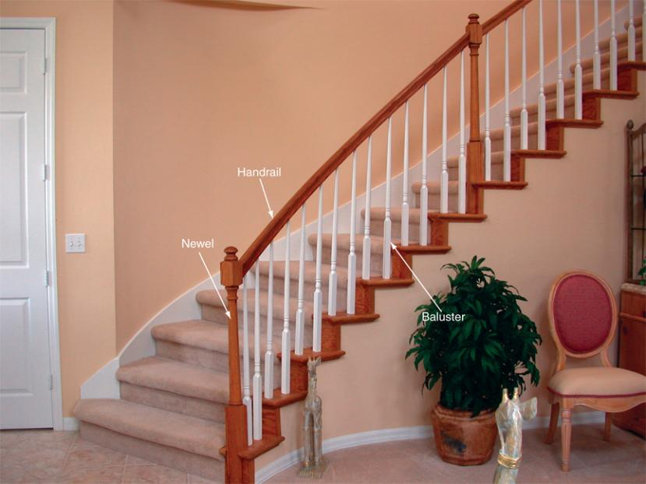
Handrails and Guardrails
Note the newel, handrail, and balusters on these open stairs
Goodheart-Willcox Publisher

Slide 27
Handrails and Guardrails
Handrail height 34" to 38" above tread nosing
Handrail clearance at least 1-1/2"
Handrail length: Begins at bottom riser and ends at top riser

Slide 28
Handrails and Guardrails
Guardrail height 36" minimum on stairs and landings 30" above grade
Baluster spaced so 4" sphere cannot pass through opening

Slide 29
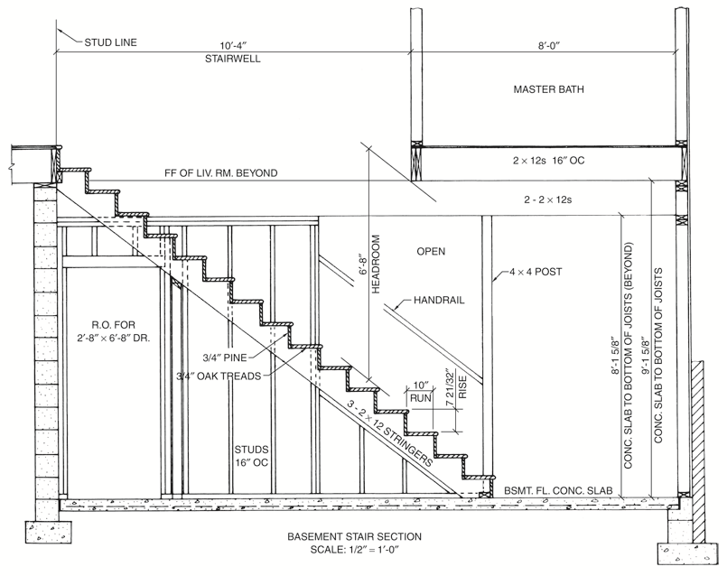
Structural Details
Construction techniques must produce stairs that are sound
Goodheart-Willcox Publisher

Slide 30
Adaptations for Special Needs
Add sturdy handrails to both sides of stairway
Cover treads with nonskid surface
Risers should be lower, treads wider than normal
Elevator or ramp may also be required
To accommodate those who cannot use stairs

Slide 31
Stairlifts and Elevators
For people who cannot climb stairs
Stairlift carries person on seat built into a fixture on a wall
Some stairlifts lift person in a wheelchair
Elevator may be a converted closet

Slide 32
Stairlifts and Elevators
A large closet can be converted into an elevator
pics721/Shutterstock.com

Slide 33
Ramps
Installed at entries of structures
Nonslip surfaces protected from the elements
Rise/run ratio is 1':12'
Longer than 30' should be in multiple sections
Minimum width for wheelchair use is 36"
Handrails on both sides of ramp for safety

Slide 34
Ramps
This private home ramp has sturdy handrails and guardrails
Les Palenik/Shutterstock.com

Slide 35
Drafting: Calculating and Drawing Stairs
1. Determine total rise of stairs
2. Determine how many risers will be required by dividing total rise by seven
3. Determine tread size and total run that yields slope between 30° and 35°
4. Calculate total run by multiplying tread width by number of treads

Slide 36
Drafting: Calculating and Drawing Stairs
5. Lay out total run tread widths; in CADD use DIVIDE command to determine location
6. Darken tread and riser lines, draw bottom edge of stringer, locate stairwell rough opening size
7. Remove all construction lines, add dimensions and notes

Slide 37
Drafting: Calculating and Drawing Stairs
Goodheart-Willcox Publisher

Slide 38
Drafting: Calculating and Drawing Stairs
Goodheart-Willcox Publisher

Slide 39
Drafting: Calculating and Drawing Stairs
Goodheart-Willcox Publisher

Slide 40
Drafting: Calculating and Drawing Stairs
Goodheart-Willcox Publisher

Slide 41
Drafting: Calculating and Drawing Stairs
Goodheart-Willcox Publisher

Slide 42
Parametric Modeling: Creating Stairs
1. Open the Basement Floor plan view, access the STAIR command
2. Access appropriate option of the STAIR command to draw a straight run of component-based stairs
3. Pick first point of the run and move cursor in direction of the travel for the stairs

Slide 43
Parametric Modeling: Creating Stairs
4. Create the floor opening for the stairs on the first floor
5. Depending on the type of stairs created, the program typically generates railings by default; access RAILING command
6. Add the appropriate dimensions and notes to the plan view drawings

Slide 44
Networking
Employability
People exchanging information or services
Goal is to learn about possible job leads
Social networking sites often contain information about companies and available positions
The sites expand job search resources and allow exchange between users and company representatives

