Slide 2
Chapter 25
Fireplace, Chimney, and Stove Details

Slide 3
Objectives
Identify the parts of a standard masonry fireplace and chimney.
Compare various types of fireplaces that are appropriate for a residence.
Apply the appropriate principles to design a typical fireplace.
Explain the difference between a radiant and circulating stove.

Slide 4
Introduction
Fireplace is an important design consideration, often a focal point
Many fireplaces fail to operate properly
Fireplaces must perform safely and according to local building codes

Slide 5
Fireplace
Breadmaker/Shutterstock.com

Slide 6
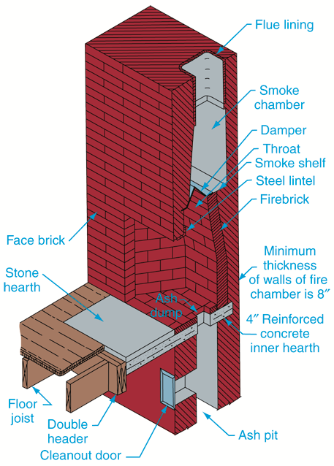
Parts of a Fireplace
Fire chamber
Hearth
Damper
Smoke shelf
Flue
Goodheart-Willcox Publisher

Slide 7
Fire Chamber
Fire chamber is heart of fireplace
Lined with firebrick
Fireclay is bonding material between firebricks
Shape of fire chamber is critical
Wall thickness on back and sides should be at least 8" thick

Slide 8
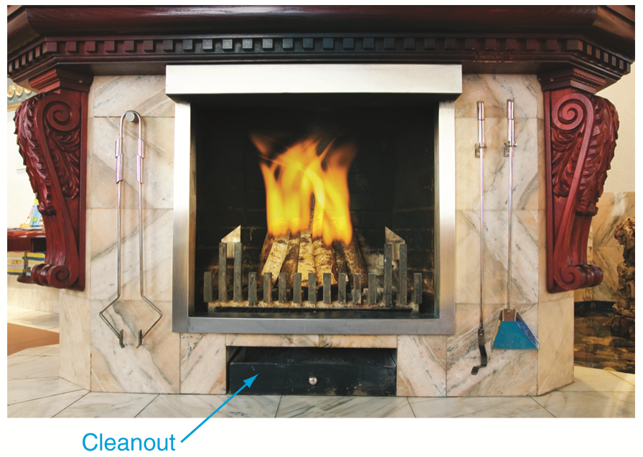
Ash Dump
Cavity where ashes collect and be removed
Ashes are removed through cleanout
Nejron Photo/Shutterstock.com

Slide 9
Hearth
Area around wood-burning fireplace that protects floor from sparks
Made of noncombustible material
May be even with floor or raised
Should extend at least 16" in front of fireplace
Inner hearth makes up floor of firebox

Slide 10
Hearth
Black slate tile of this hearth extends into room to protect wood floor from sparks
Iriana Shiyan/Shutterstock.com

Slide 11
Damper
Regulates airflow and stops downdrafts when fireplace is not operating
Located in throat of fireplace
Damper opening
Larger than area of flue lining and as long as width dimension of fireplace
Placed 8" above top of fireplace opening

Slide 12
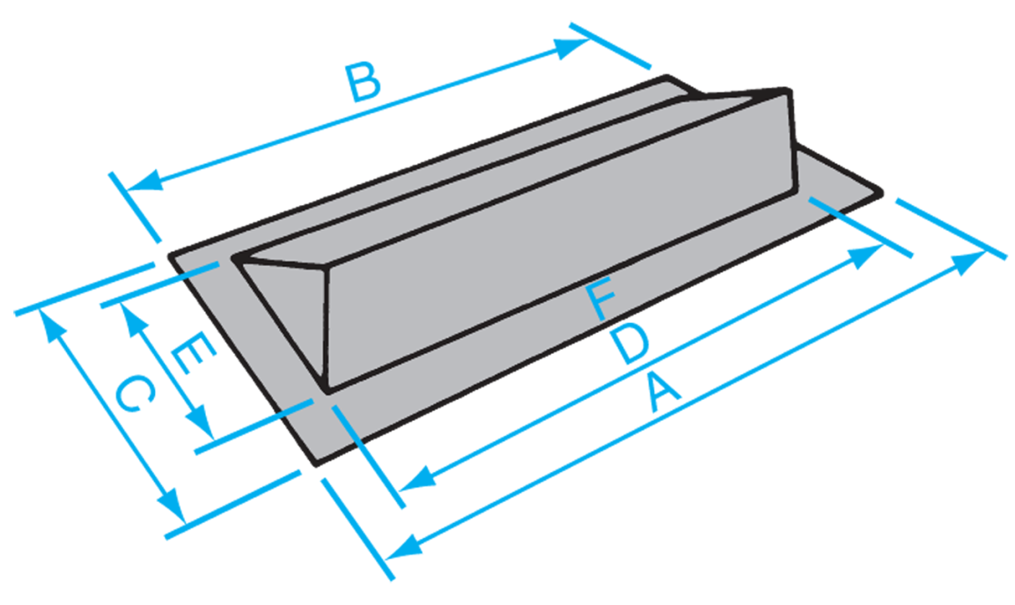
Damper
Typical design specifications
Donley Brothers Company

Slide 13
Smoke Shelf and Smoke Chamber
Smoke shelf
Deflects cold air flowing down chimney upward into rising warm air from fire
Smoke chamber
Directs smoke up and away from firebox and into flue

Slide 14
Chimney and Flue
Chimney is freestanding, vertical structure that allows smoke to leave the home
Flue is path that conducts smoke safely to top of chimney and into outside air

Slide 15
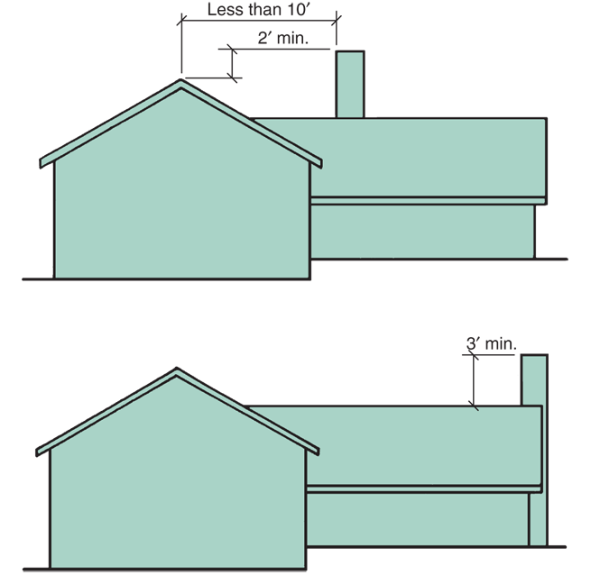
Chimney and Flue
Recommended chimney heights above the roof
Goodheart-Willcox Publisher

Slide 16
Flue
Begins at top of smoke chamber and extends to top of chimney
Clay lining
Requires at least 4" of masonry on all sides
Each fireplace must have its own flue

Slide 17
Flue Size
At least 1/10th of fireplace opening
Proper flue size is related to fireplace opening size, flue height, flue location in structure
Flue must be at least 2' above highest point of roof

Slide 18
Framing
Required clearances:
2" between chimney and framing at front and sides of fireplace
4" at back side of fireplace
Openings in floor, ceiling, and roof through which chimney passes must have double headers and trimmers

Slide 19
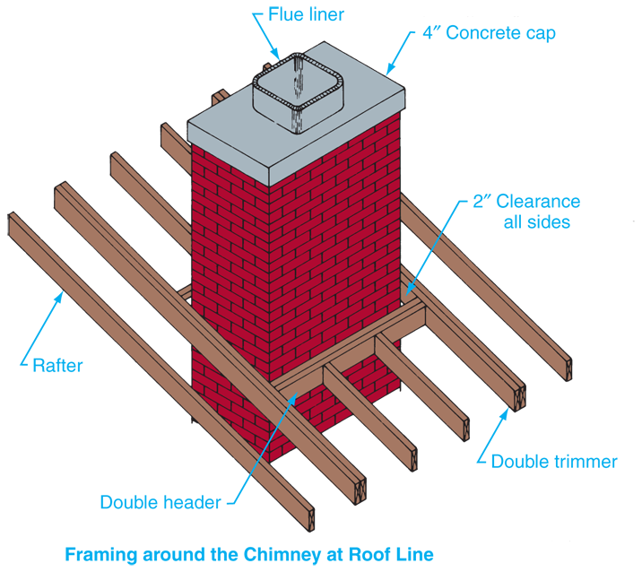
Framing
Goodheart-Willcox Publisher

Slide 20
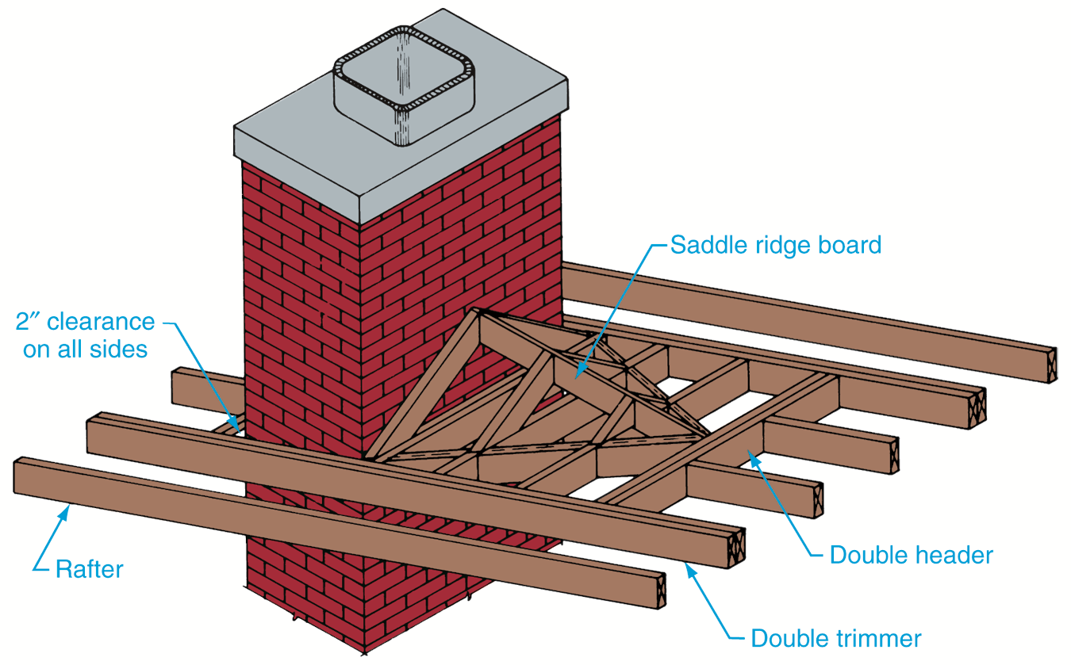
Framing
Saddle or cricket is built on high side of chimney to shed water on single slope roof section
Goodheart-Willcox Publisher

Slide 21
Framing
Masonry above fireplace opening on interior of house must be supported by lintel
Angle steel lintel is most common
Lintel size depends on width of fireplace opening

Slide 22
Fireplace Design
Design factors:
Homeowner’s preference and budget
General style of house
Some CADD packages automate the process of specifying fireplaces

Slide 23
Fireplace Specifications
Single-face fireplace
Two-face opposite fireplace
Two-face adjacent fireplace
Three-face fireplace

Slide 24
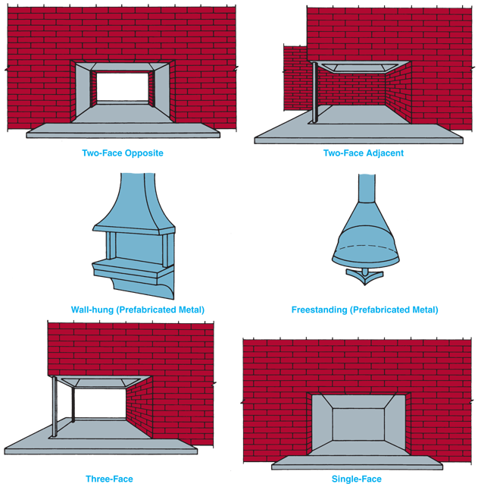
Fireplace Specifications
Goodheart-Willcox Publisher

Slide 25
Prefabricated Metal Fireplaces
Made of steel
Include:
Inner hearth
Fire chamber
Throat
Damper
Smoke shelf
Smoke chamber
Goodheart-Willcox Publisher

Slide 26
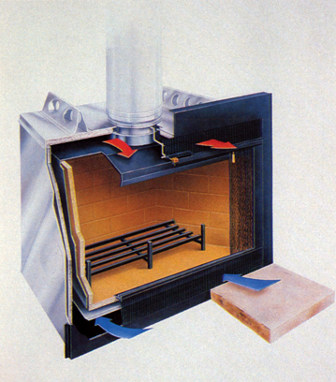
Prefabricated Metal Fireplaces
Heat recirculation feature draws air in from room, heats it, and returns warmed air to room
Consult local building codes prior to installation
Heatilater, Inc.

Slide 27
Stoves
Radiant stoves
Warms through radiant heat, which passes through air with no assistance from airflow
Circulating stove
Uses airflow and radiant heat
Outer jacket facilitates air movement
Safer and may be placed closer to combustible material than radiant stoves

Slide 28
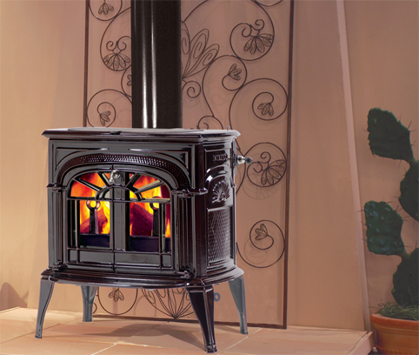
Catalytic Stove
Wood-burning stoves that use a ceramic catalyst for increased efficiency
Vermont Castings

Slide 29
Stove Efficiency
Low-efficiency stoves
20% to 30% efficient
Medium-efficiency stoves
35% to 50% efficient
High-efficiency stoves
Over 50% efficient

Slide 30
Pellet Stoves
Green Architecture
Burn pellets made from wood by-products, corn, or some types of grain
Pellets are carbon-neutral fuel and leave very little residue
Sealed, double-walled vent system is required to channel exhaust gases out

Slide 31
E-mail Etiquette
Employability
Use appropriate tone
Do not use emoticons
Mention attachments
Do not forward jokes or spam
Never use profanity or respond in anger
Avoid overuse of e-mail
Avoid using all caps

